Slide 1
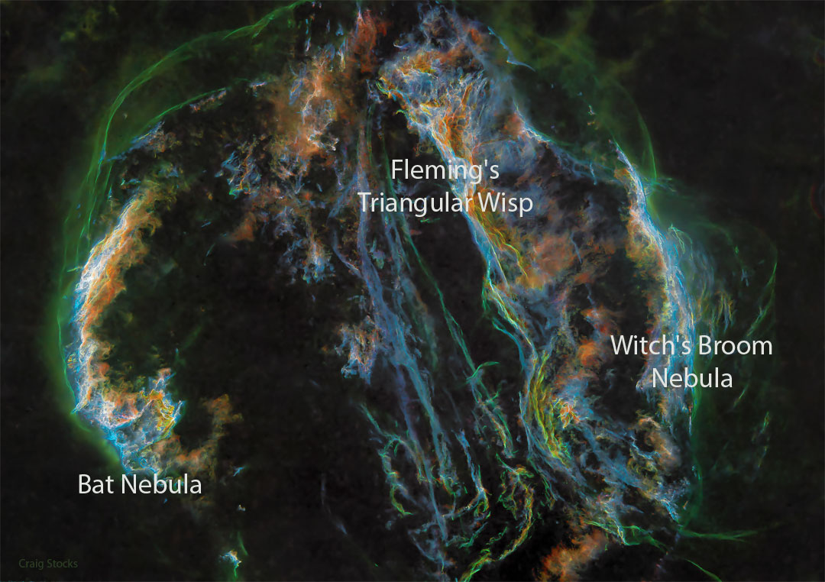
Particle Acceleration in Radiative Shock Waves
John Raymond
How do Radiative Shocks in
old SNRs produce non-thermal
radio emission and
gamma-rays?
Cygnus Loop
D=800 pc, d=45 pc, 21,000 yrs
Development of turbulence
CR acceleration, B amplification
APOD – June 22, 2022. Craig Stocks

Slide 2
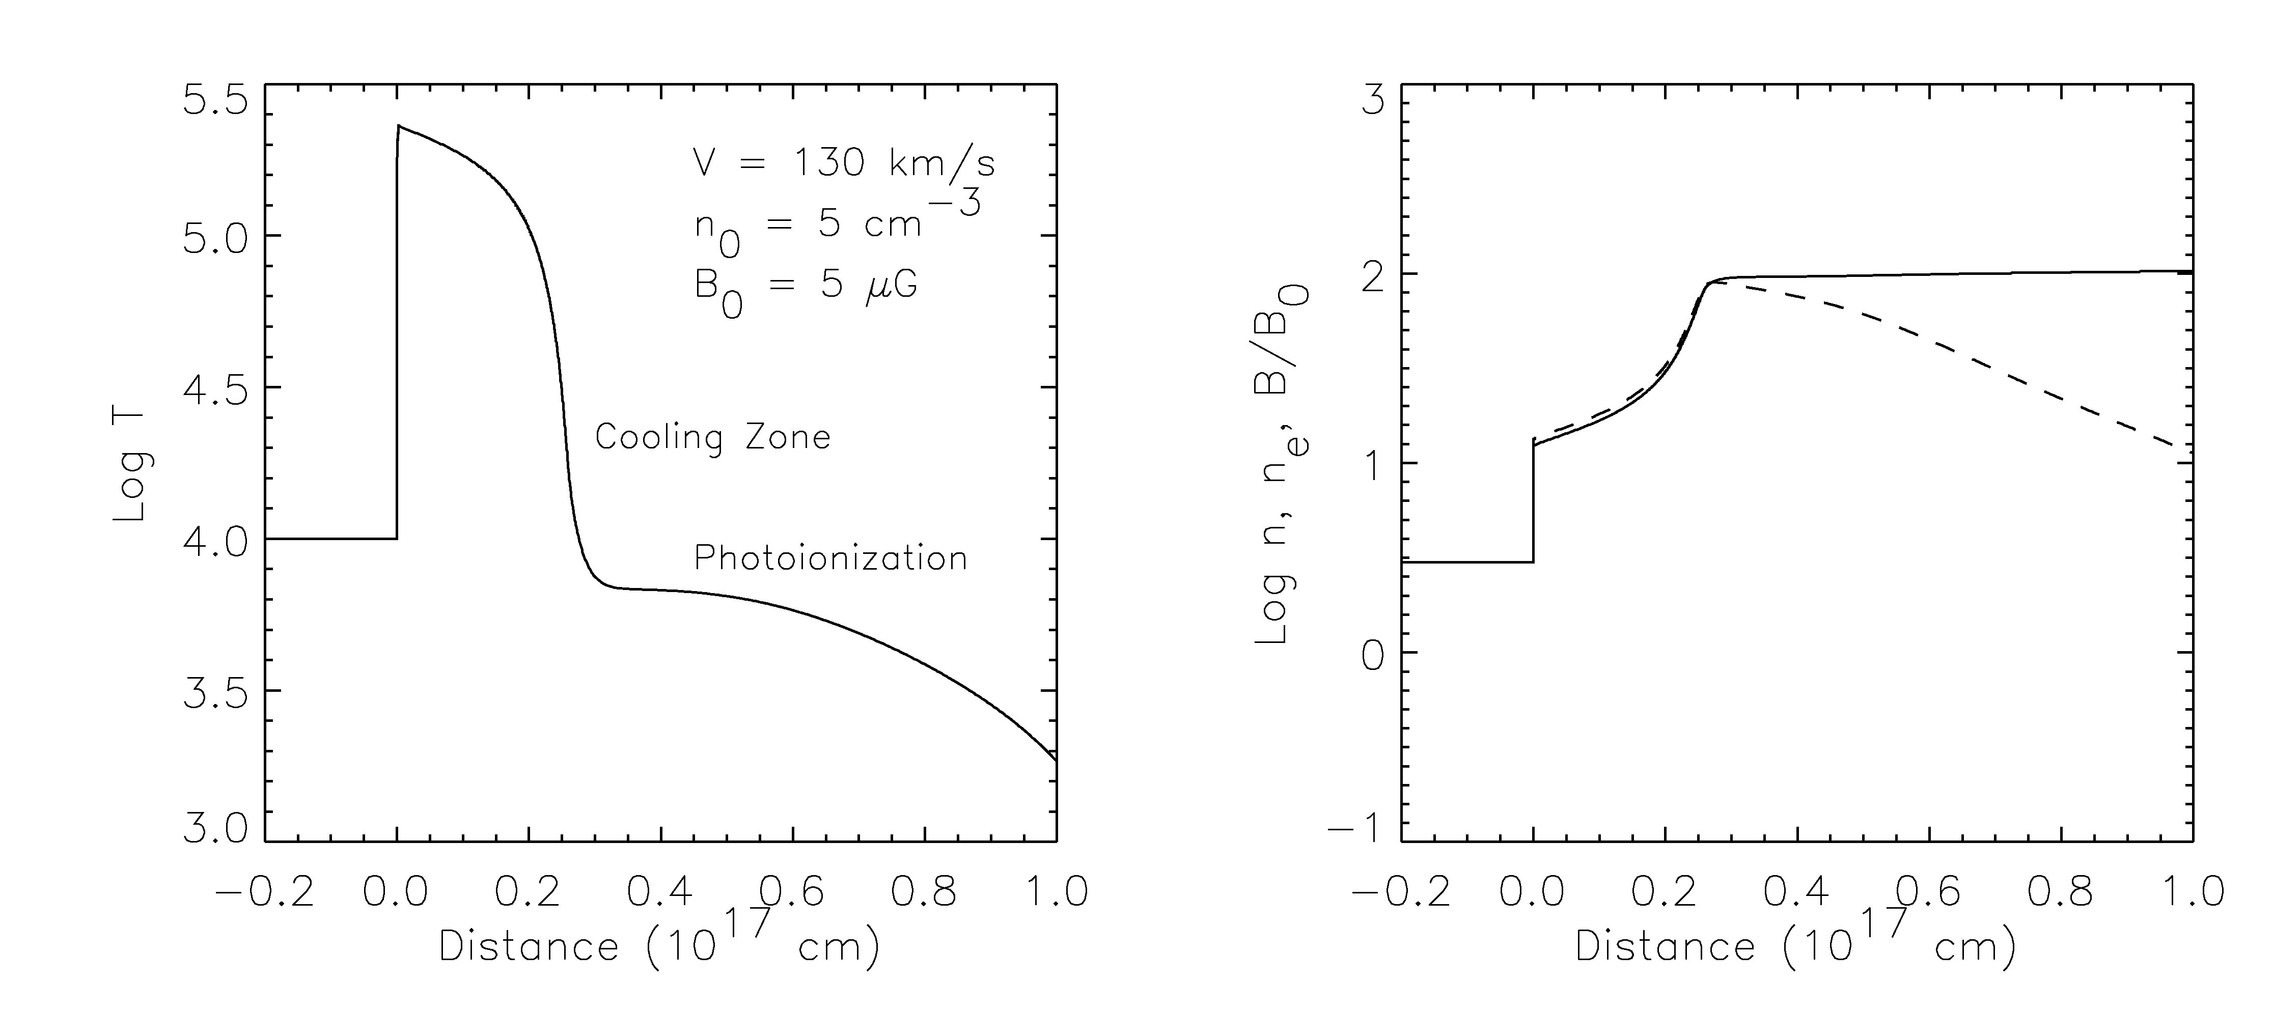
Terminology: Radiative Shocks
Radiative losses cool gas
Subsonic constant pressure, strong compression
Photons from cooling zone ionize recombining gas, “H II region”
High plasma β (50) goes to low plasma β (1/5)

Slide 3
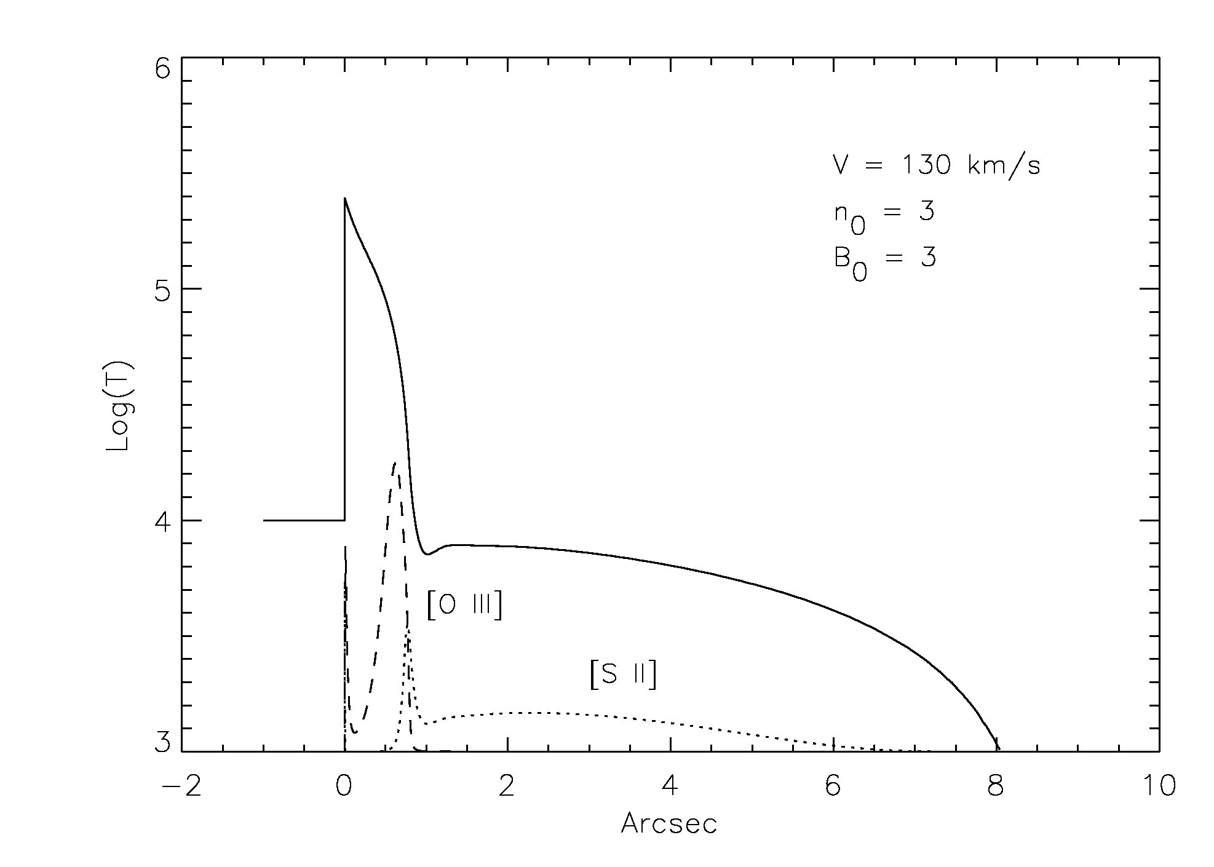
1D Steady-Flow Shock Model
Smooth 1” wide [O III] filaments followed by 4” thick [S II] filaments
(Thinner for n₀ ~ 5)

Slide 4
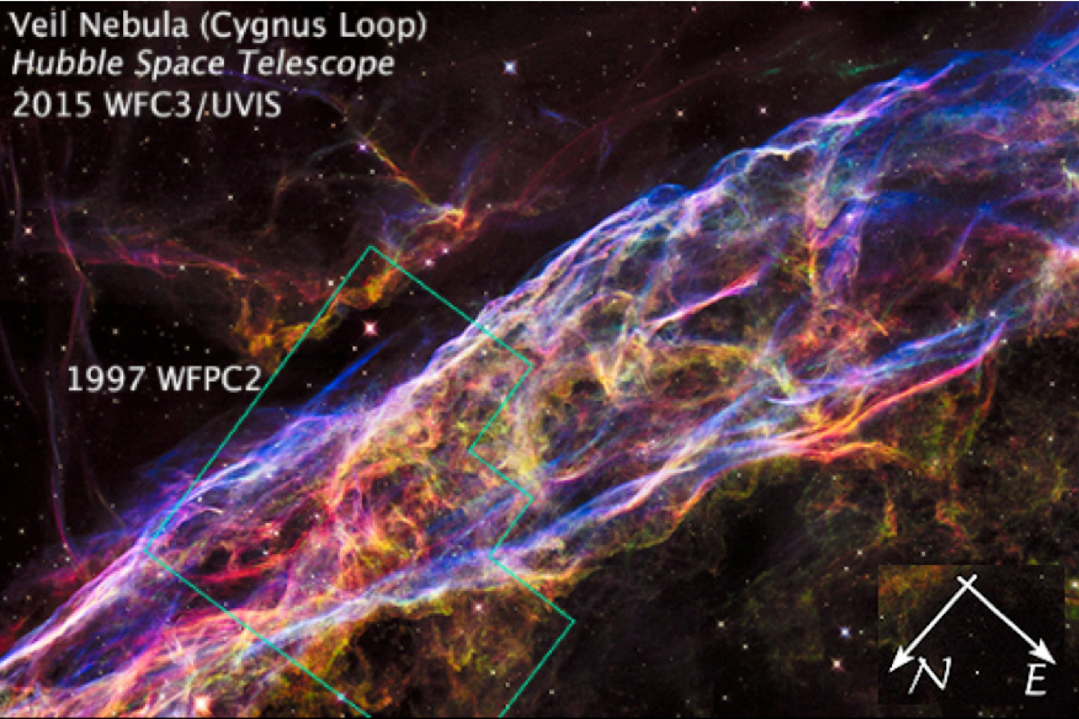
Hubble Heritage Mosaic
5.8’ = 1.3 pc
Blue = [O III], Red = Hα + [N II], Green = [S II]

Slide 5
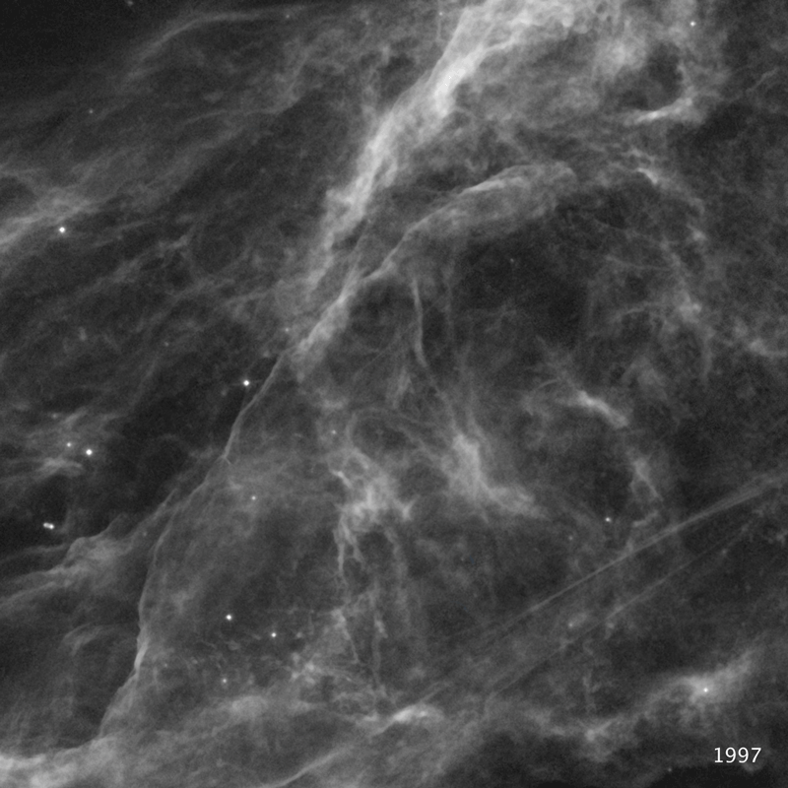
Hubble Heritage Project
Hα changes from 1997 to 2015
V=150 km/s (proper motion, 800 pc)
Considerable variation
Hα much different than [O III]
generally smaller
(2D, projection effects)
Non-radiative shocks in northern
Cygnus Loop are faster: Vuketic et al.

Slide 6
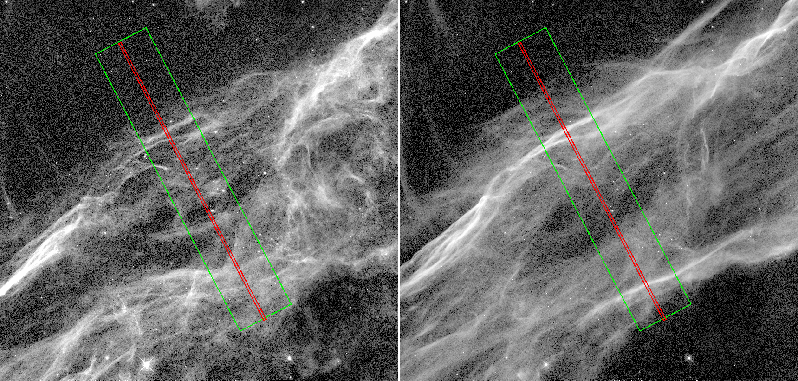
Hubble Heritage Mosaics
Hα + [N II]
[O III]
Binospec
Spectra
Evolves from smooth rippled sheet at 50,000 K to spidery, clumpy threads at 10,000 K

Slide 7
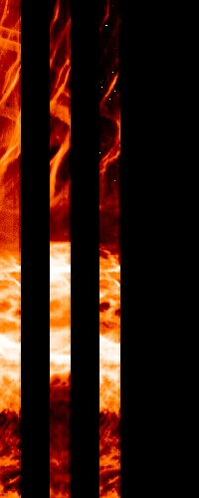
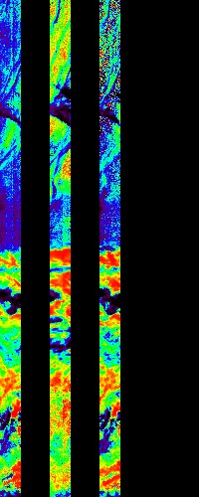
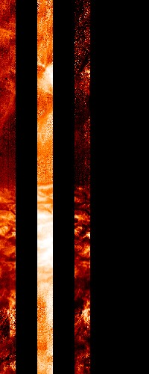
Intensity: 0-3x10⁻¹⁵ Velocity: -50-+50 FWHM: 0-150
6’
Hα O III S II
25 Binospec long slit spectra

Slide 8
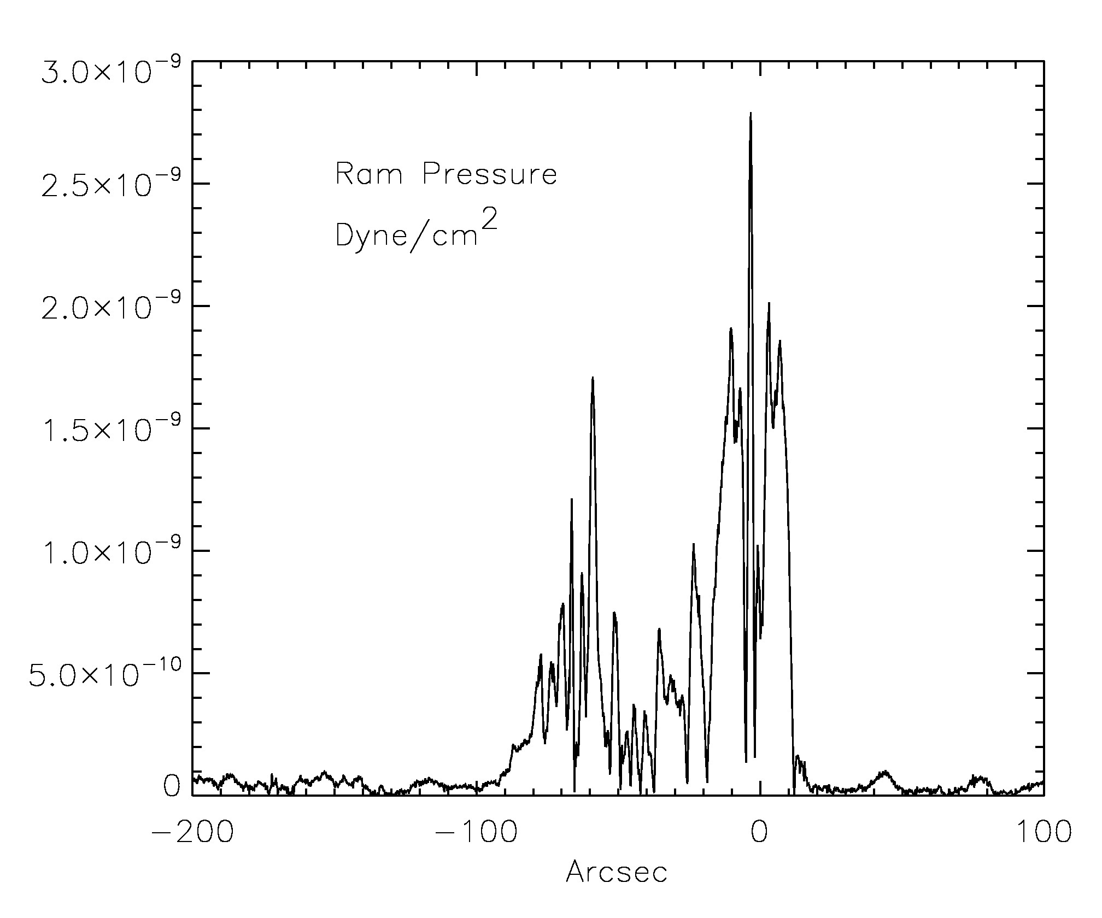
Ram Pressure: ρV²
Don Cox trick:
N = # of photons/atom
V_{DOPP}I_{obs} = V_{SHOCK} sinθ x I₀ / sinθ
= n₀ V_{SHOCK}² x N x hν/4π
= const. x Ram Pressure
V ~ 130 km/s implies n₀ ~ 5 cm⁻³

Slide 9
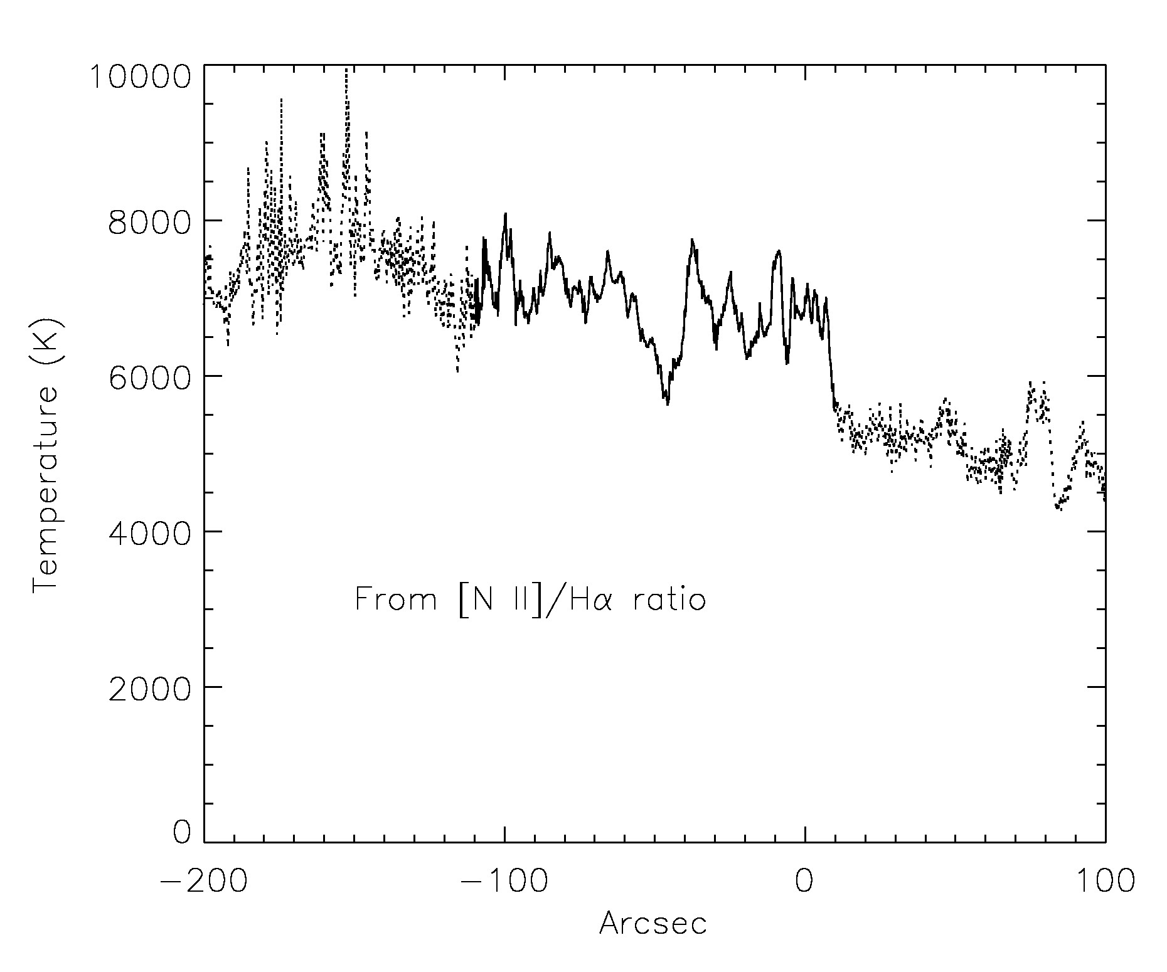
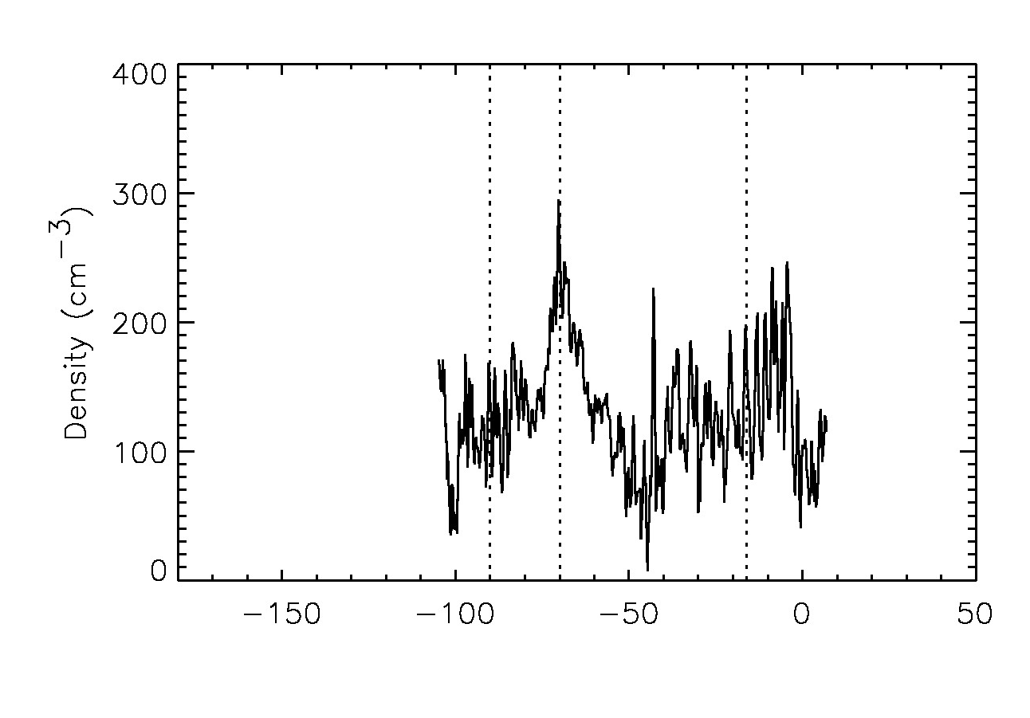
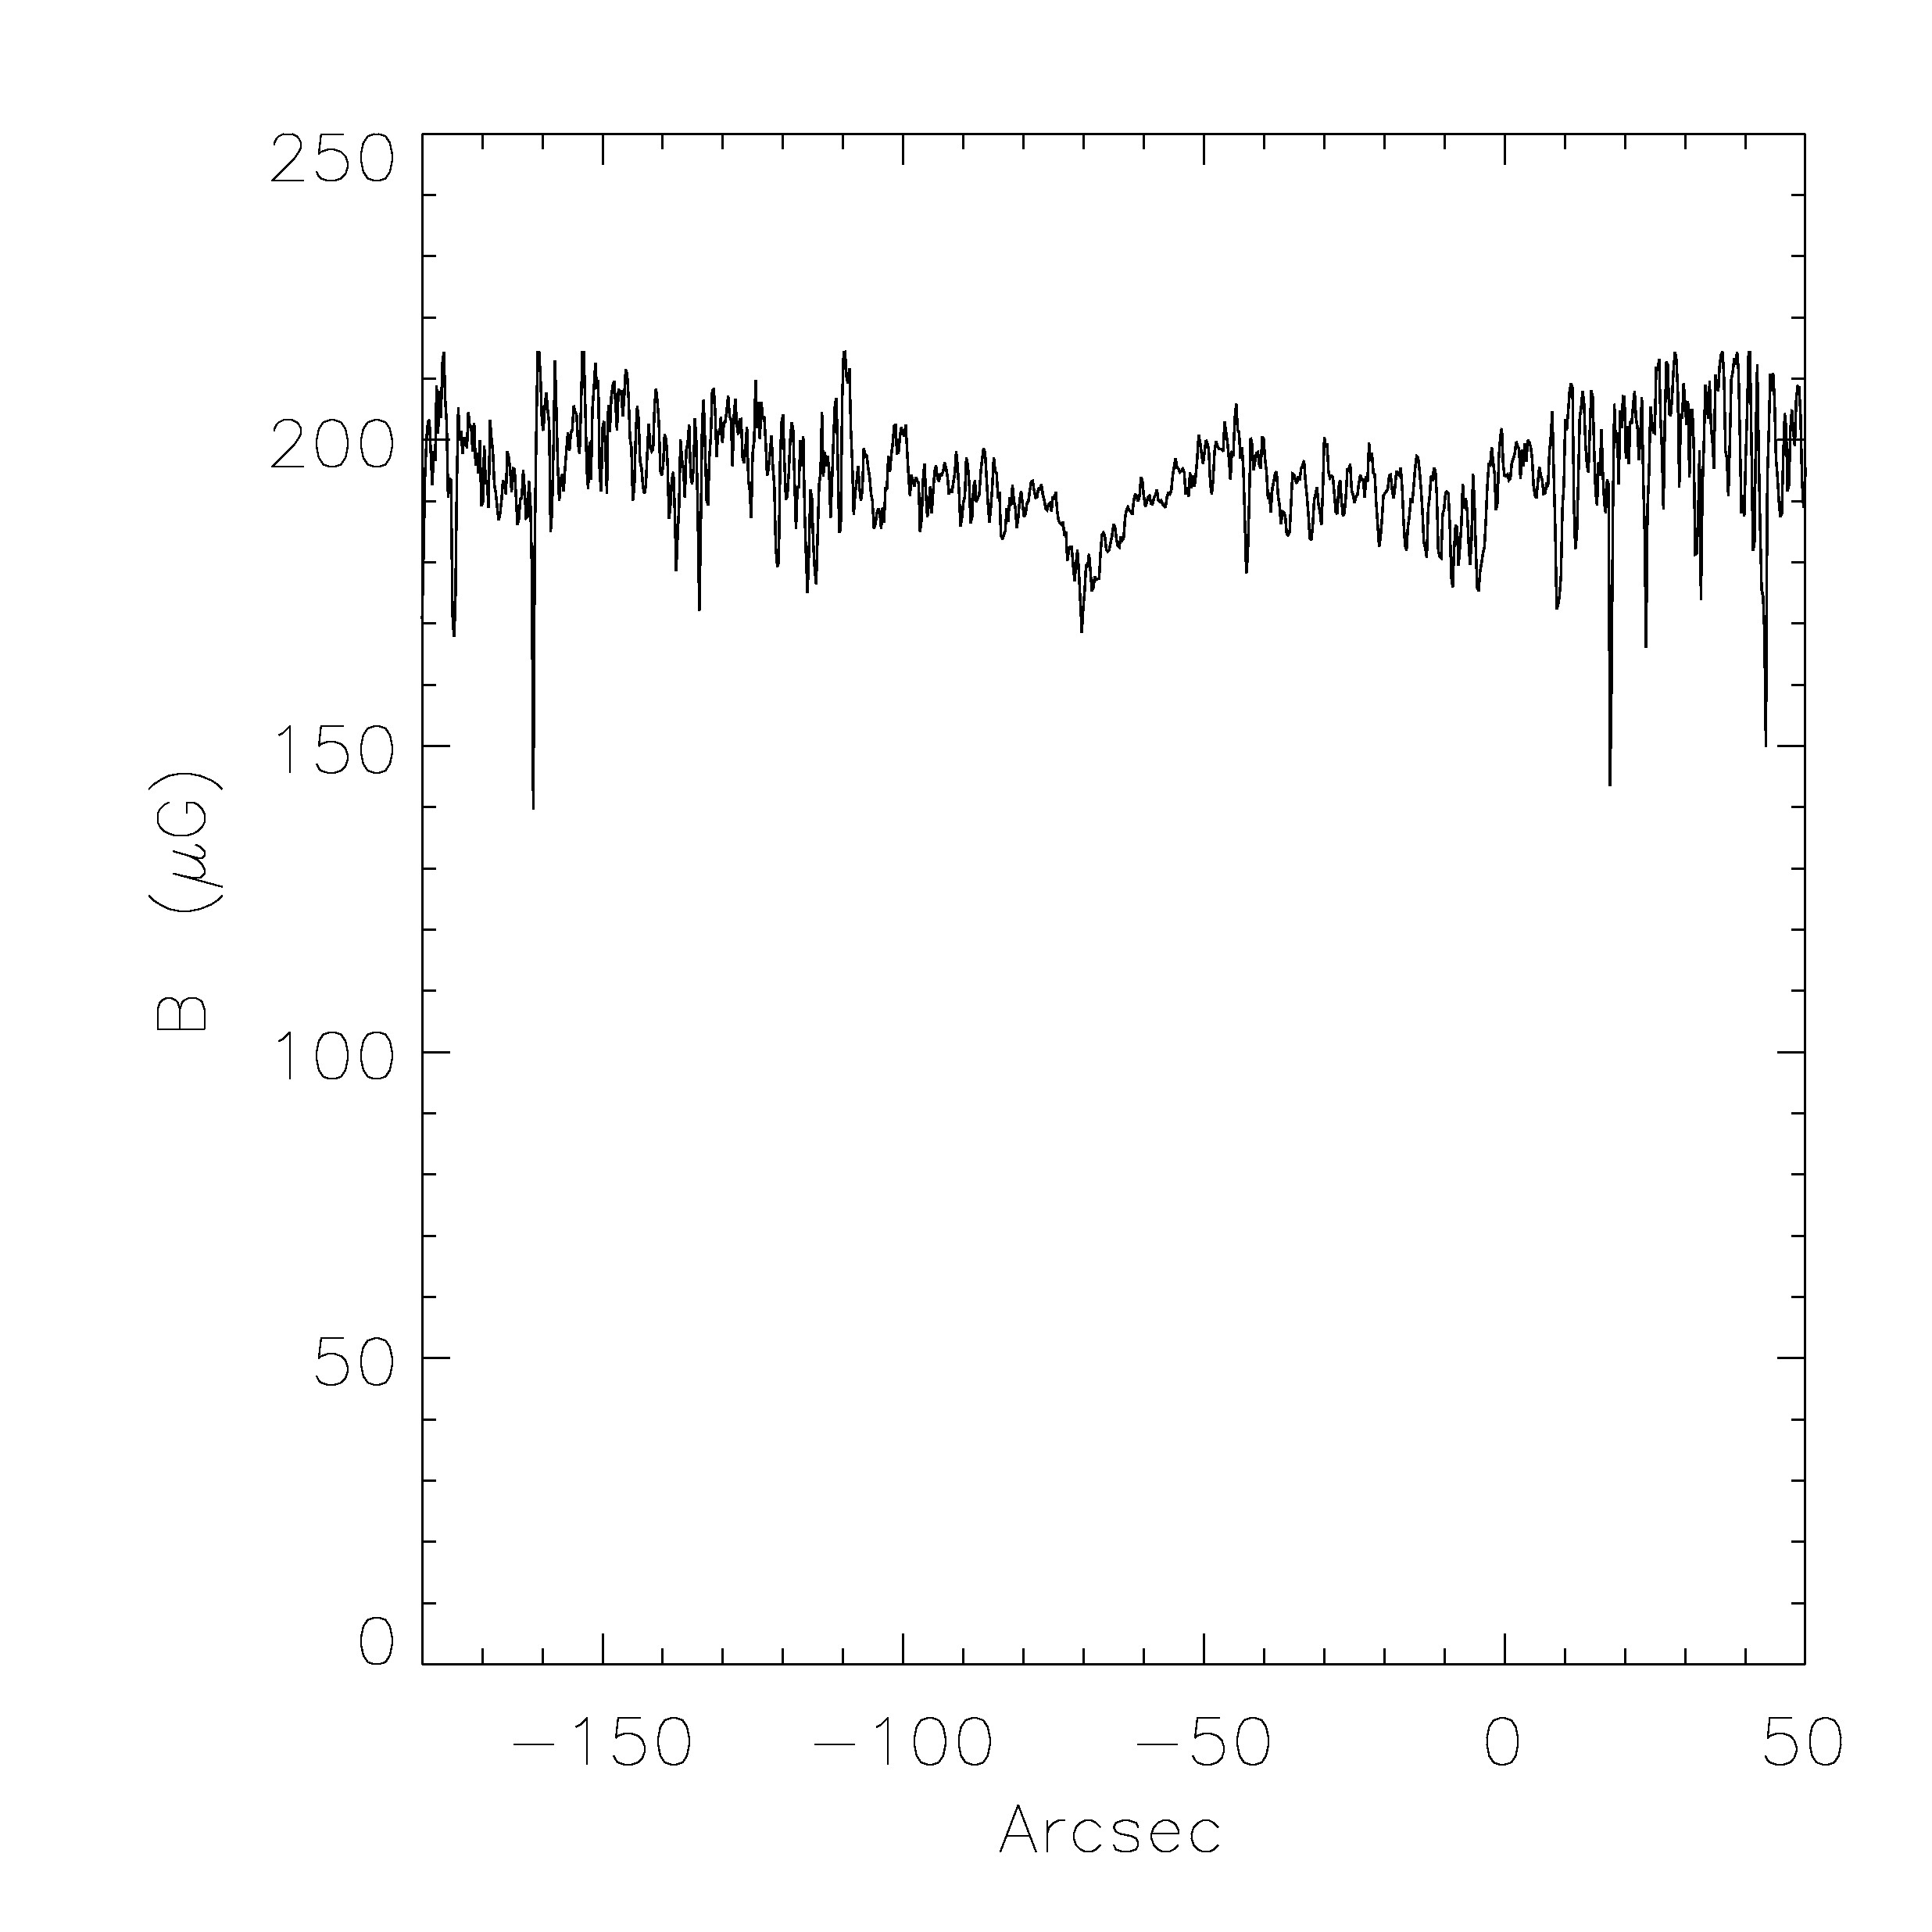
T From
[N II]
Density
From
[S II]
Ram Pressure
From
[O III]
B from
Ram pressure
Minus
Thermal

Slide 10
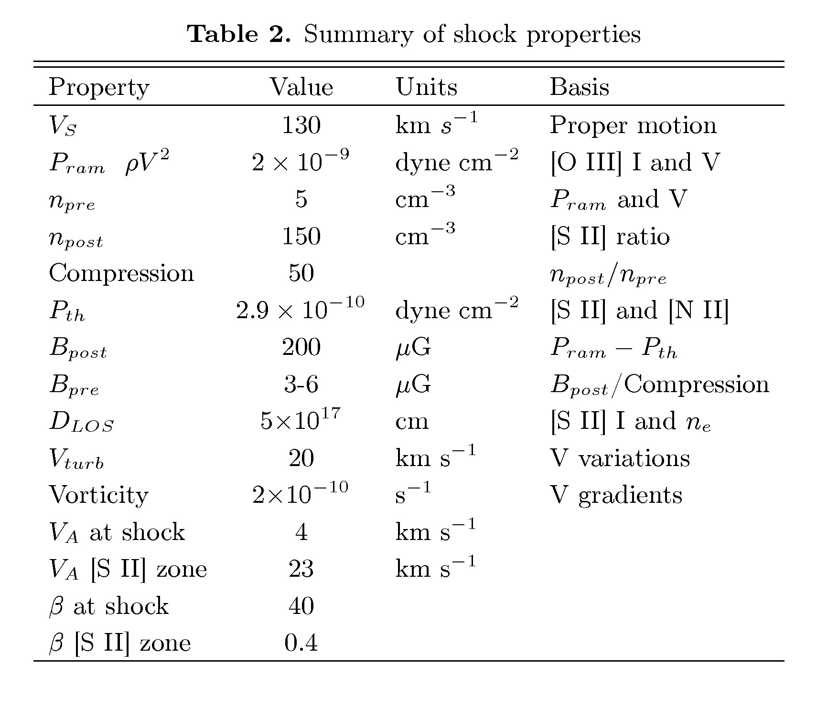

Slide 11
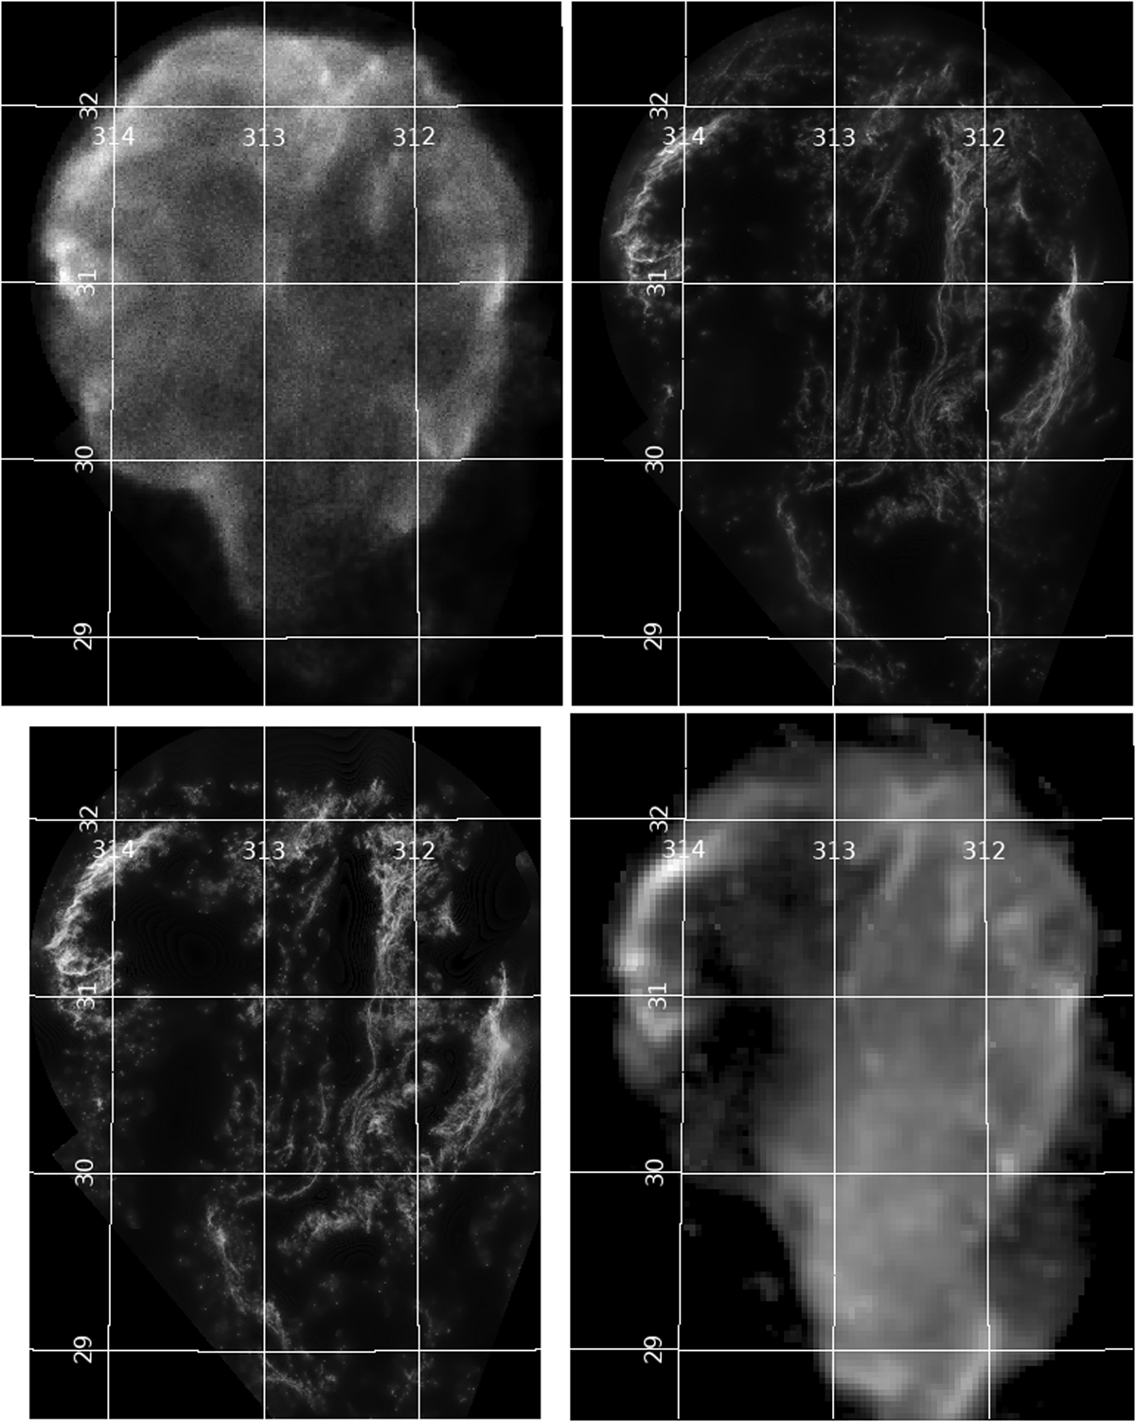
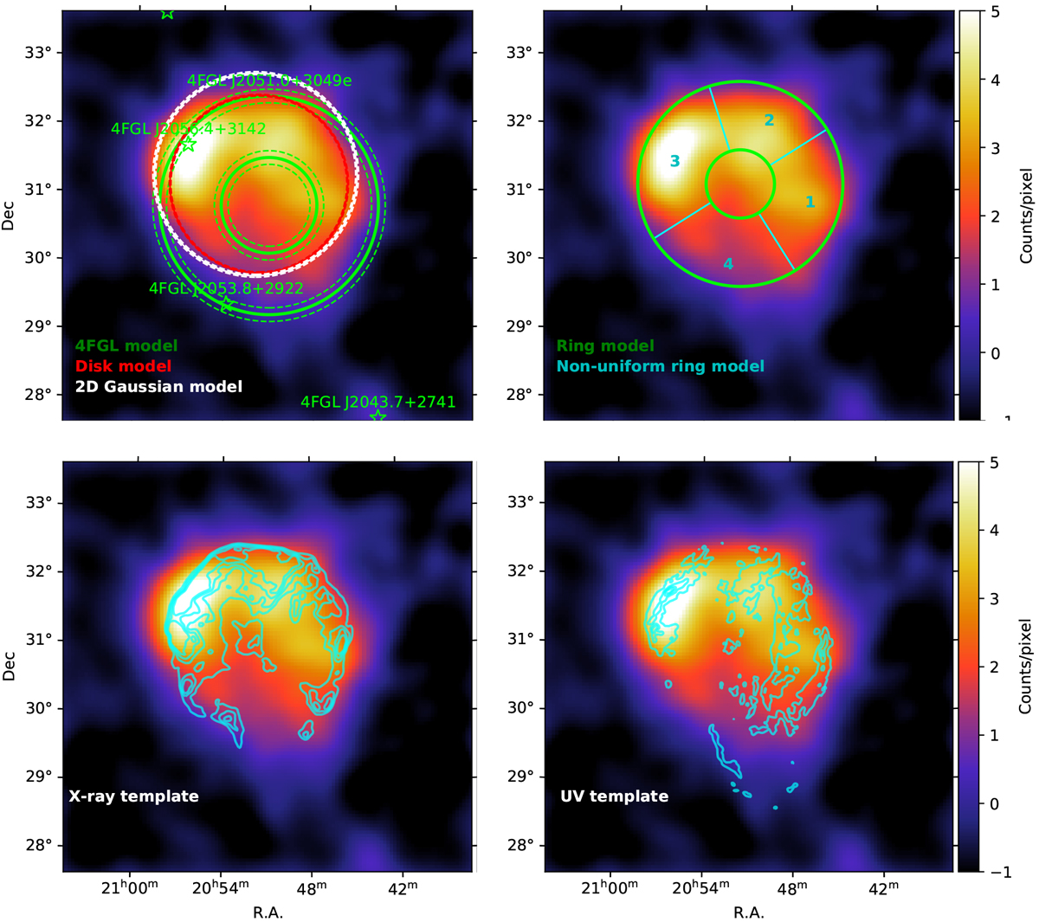
Tutone et al 2021
8 years of Fermi
X-ray
NUV
Radio
Hα
Hadronic gamma-rays (Katagiri et al.)

Slide 12
Cygnus Loop Gamma Rays
To first order, Reacceleration at shock is not needed to explain γ-rays.
Adiabatic compression of ambient CR and high density
To first order, acceleration by turbulence downstream is not needed.
L_{γ} ~ 2x10³³ erg/s E_{CR} ~ 6x10⁴⁵ erg cool shell
L_{RAD} ~ 7x10³⁷ erg/s E_{TH} ~ 3x10⁴⁷ erg cool shell
L_{X} ~ 7x10³⁵ erg/s E_{TH} ~ 10⁵¹ erg hot shell
L_{IR} ~ 8x10³⁶ erg/s E_{MAG} ~ 10⁴⁸ erg

Slide 13
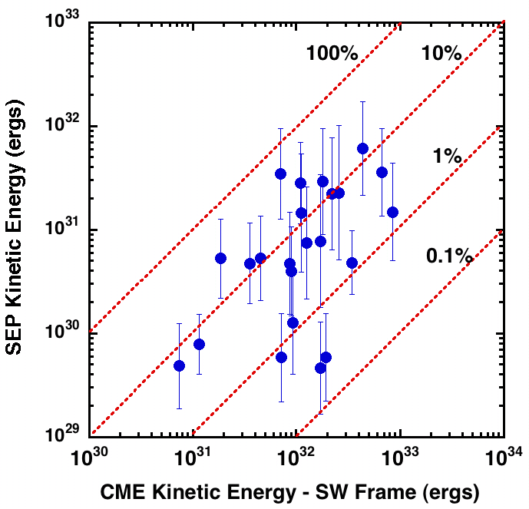
Acceleration Efficiency
Mewaldt et al.
Solar Wind:
CME-driven shocks
Need 10% for SNRs
to explain Cosmic Rays
But slower shocks are much
less efficient!

Slide 14
Slower Shock Particle Acceleration
Particles accelerated by adiabatic compression, not DSA
Radio – van der Laan; Blandford & Cowie; Cox et al.
Diffusive Shock Reacceleration: Cristofari & Blasi; compress and flatten
Turbulence:
Particles accelerated if trapped in contracting magnetic islands
solar flares – Drake et al. or shocks -- Zank et al.
Particles accelerated by reconnection E fields in coalescing islands
Zank et al. for shocks; Can alter spectrum
Downstream turbulence: Giacalone & Jokipii

Slide 15
4
Voyager 1 local Cosmic Rays
Cummings et al.
Less than inferred from cloud
Ionization rates
Steep electrons mean
reacceleration makes
a big difference.
Flat protons at 0.1 GeV
(m² s sr MeV)⁻¹
0
-4

Slide 16
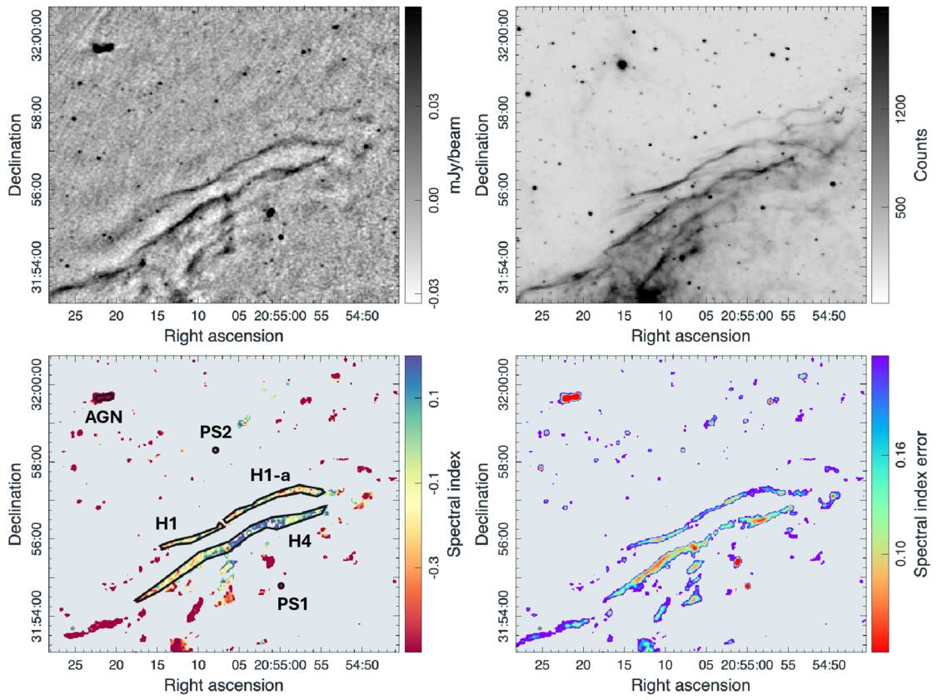
Most of the radio
from bright Hα filaments
is thermal free-free
Urosevic et al. 2026
Spectral index and ratio to
Hα both indicate thermal
emission

Slide 17
How much is non-thermal?
All of the gamma-rays
Not much of radio in bright filaments: Bremsstrahlung from 10⁴ K gas
Proportional to Hα from recombination: n_{e} n_{H+}
Urosevic et al.
Different spectral indices: affected by reacceleration?

Slide 18
Summary
Radio and gamma-ray emission from radiative shocks is consistent
with van der Laan compression or reacceleration of ambient CRs
and compression of B field and gas.
Error bars are substantial; need better spatial resolution for radio
and gamma-rays.
Consistent with low DSA acceleration efficiency for slow shocks.

Slide 20
Encore!
Turbulence
Important for SN feedback on ISM and perhaps particle acceleration

Slide 21
Hubble Heritage Mosaics
Hα + [N II]
[O III]
Binospec
Spectra
Evolves from smooth rippled sheet at 50,000 K to spidery, clumpy threads at 10,000 K

Slide 22
Structure
Front is “sinusoidal” in [O III]: wavelengths 1” to 100”
Amplitude/wavelength ~ 0.1
Hα lags [O III] by ~ 2-3”
Hα proper motions poorly correlated with [O III], generally smaller
Hα is a spidery version of [O III] with many features added or missing
[O II] is intermediate

Slide 23
What’s Going On?
Evolves from smooth rippled sheet in O III (10⁵ K) to irregular knots and
filaments in Hα (10⁴ K); Hα structures are smaller than expected.
- Thermal Instability (t_{COOL} < t_{CROSS})
- Thin shell (Vishniac) instability (P and ram pressure misaligned)
- B fluctuations (if magnetic pressure dominates)
- Density fluctuations (V_{SHOCK} variations and Vorticity)

Slide 24
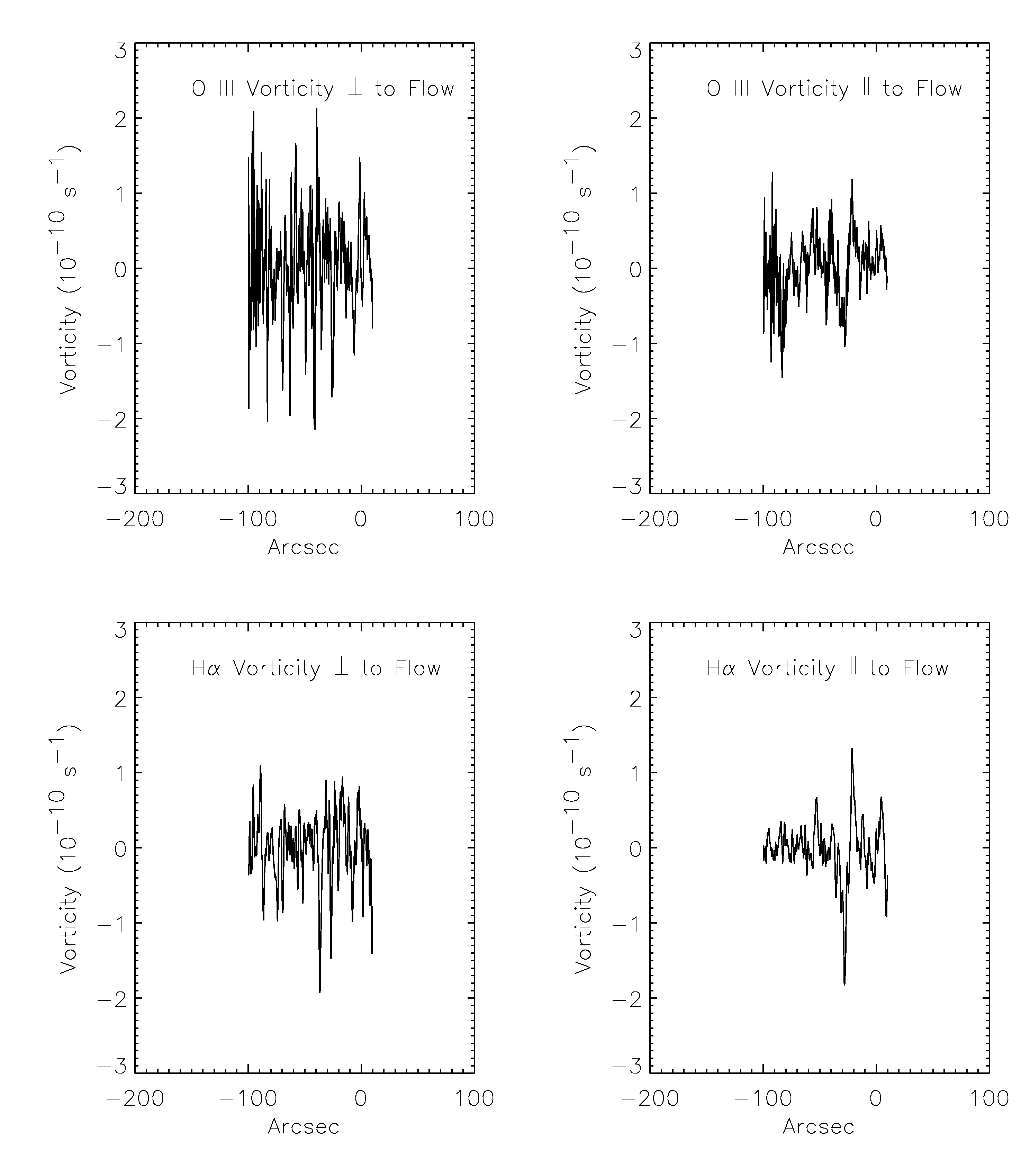
Vorticity
Line-of-sight Velocity Centroid
Gradients ⟂ and ∥ mean flow
ASSUME it is roughly an edge-on
sheet and that our LOS and LOS
from south give same distribution
ASSUME uncorrelated: (see Spangler)
(dV_{x}/dy – dV_{y}/dx)=√2 dV_{x}/dy
Scale=1”-1.5”
Turnover time > 1000 yrs ~ t_{COOL}

Slide 25
Overall
Turbulent Heating rate ~ 0.2 x Photoionization Heating
[VERY APPROXIMATE] [Entering dissipation phase?]
Turbulent Energy Content ~ Thermal Energy Content
[IN PHOTOIONIZATION ZONE]
Mechanism?
Pre-shock density structure and magnetic pressure
Magnetic Amplification and Particle Acceleration
[NEEDS MORE RADIO OBSERVATIONS]

