Slide 1
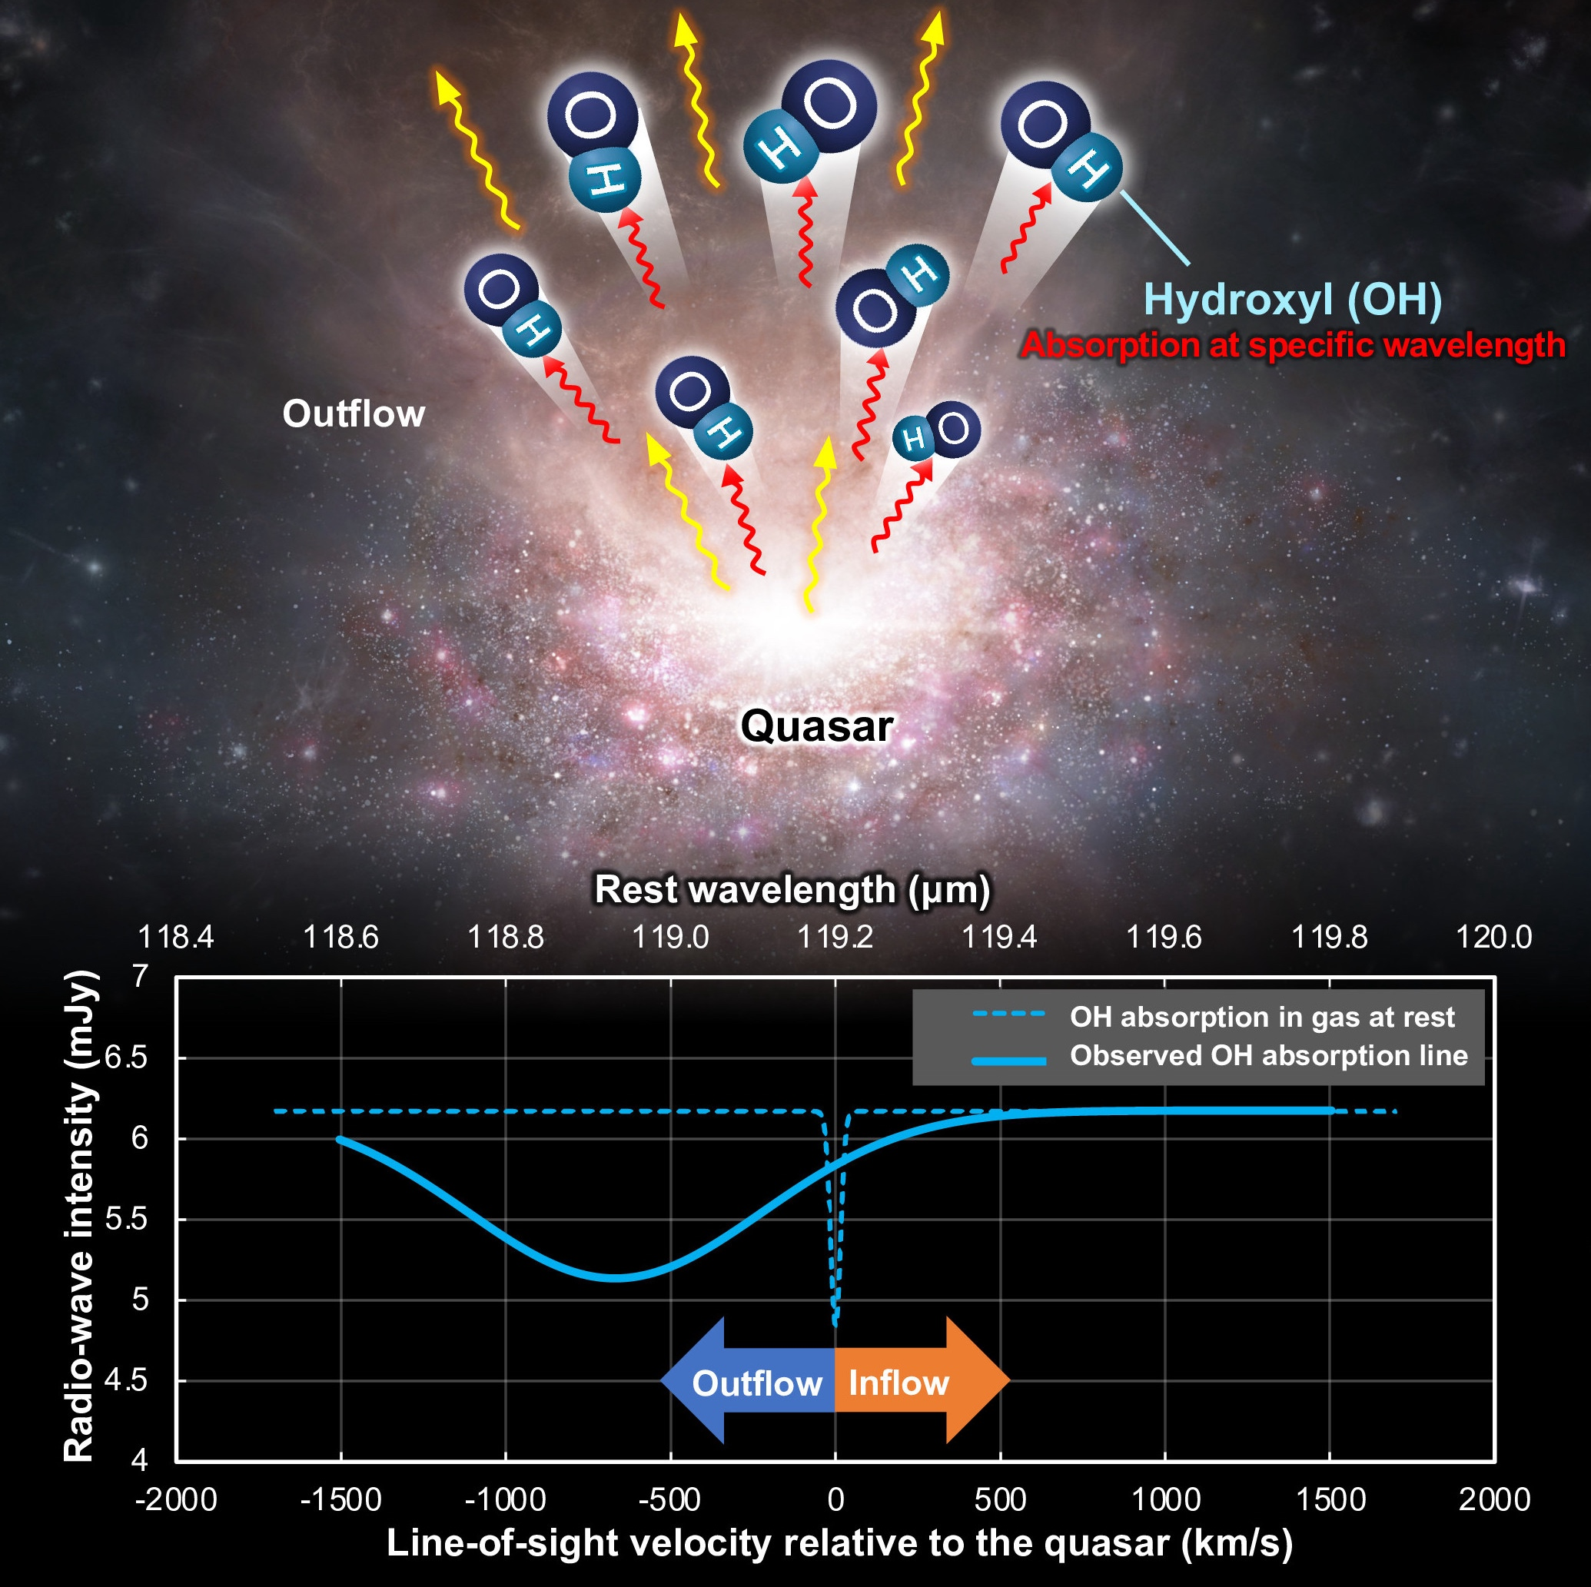
Molecular outflows at high redshift probed by absorption lines
Dragan Salak
Astronomical Institute
Tohoku University
Serbian Astronomical Conference
October 5-8, 2026

Slide 2
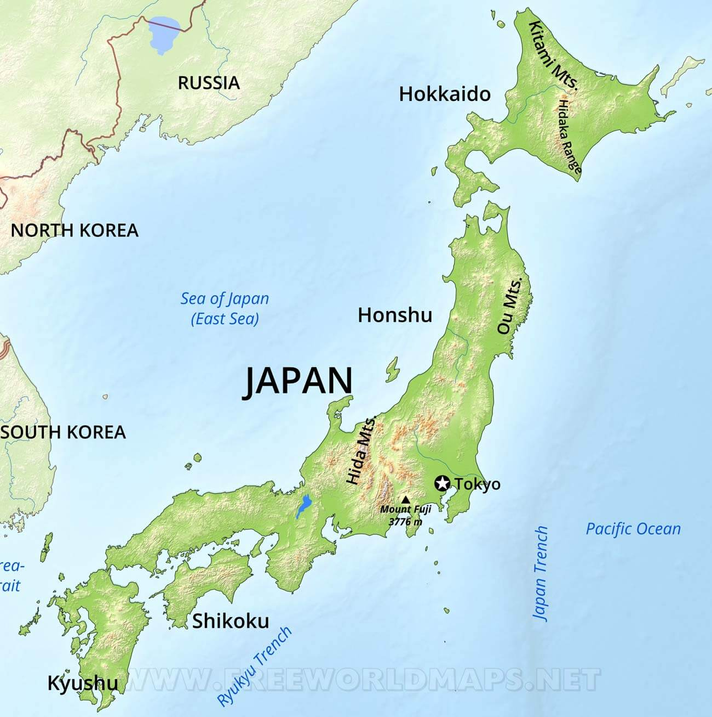

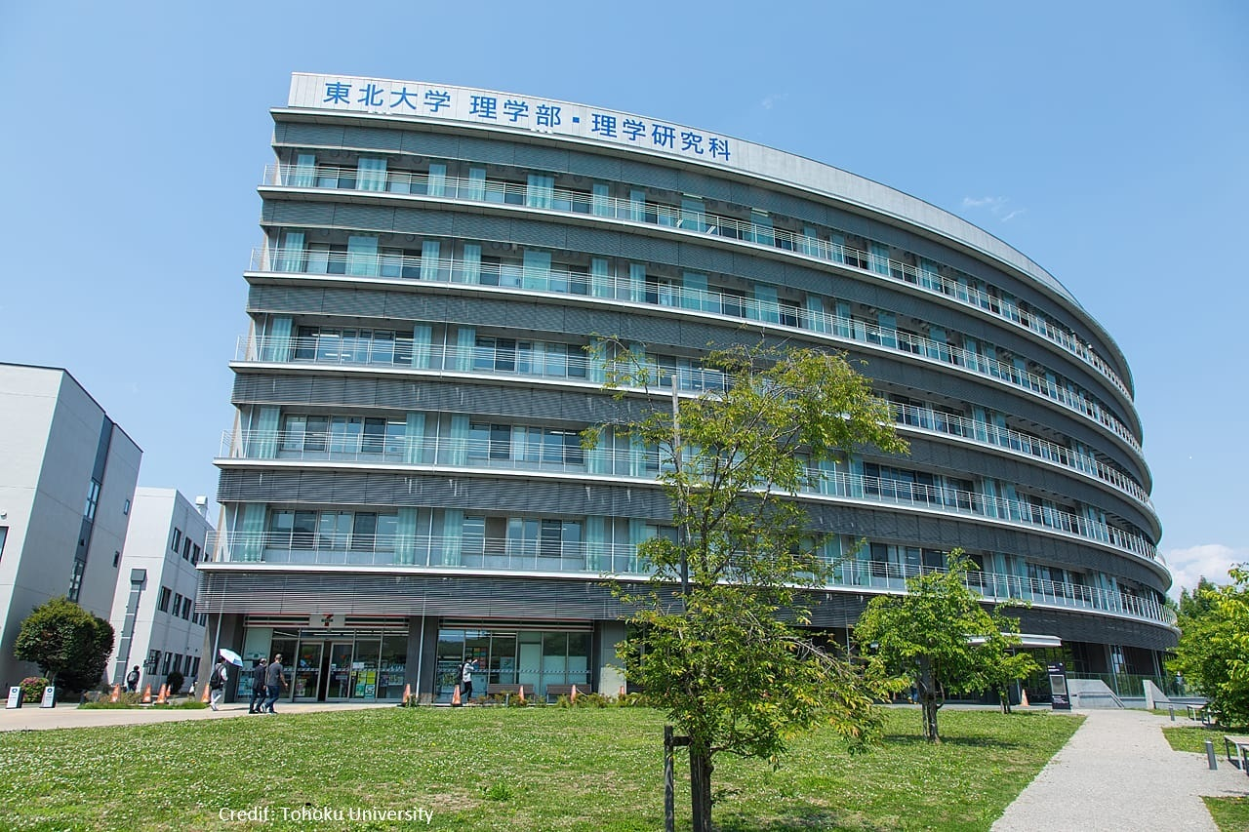
About me
Undergraduate: University of Novi Sad 🇷🇸
Master & PhD: University of Tsukuba 🇯🇵
Since 2026: Tohoku University
Sendai

Slide 3
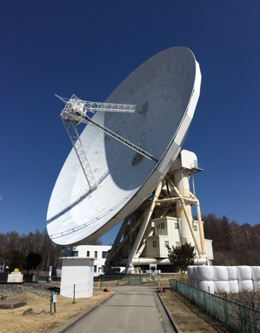
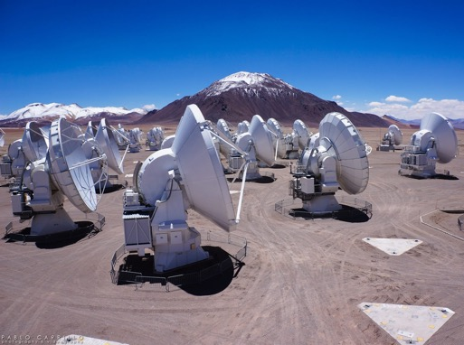
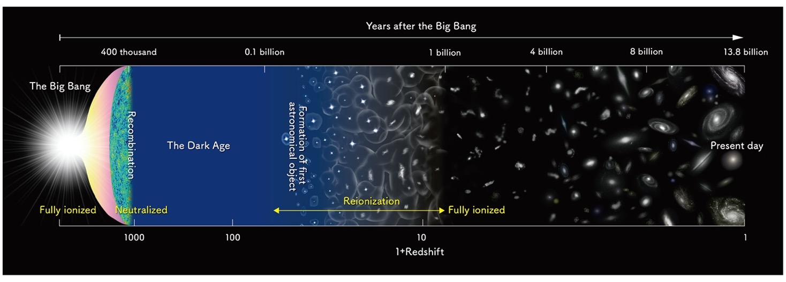

Research
Nobeyama 45 m
ALMA
Star formation
?
?
?
NAOJ
Active Galactic Nucleus

Slide 4
Outline
Baryon cycle
  Galactic outflows
Finding molecular outflows via absorption lines
ALMA observations
  OH 119 μm outflow in a QSO at redshift 6
Impact on star formation
Future prospect with PRIMA

Slide 5
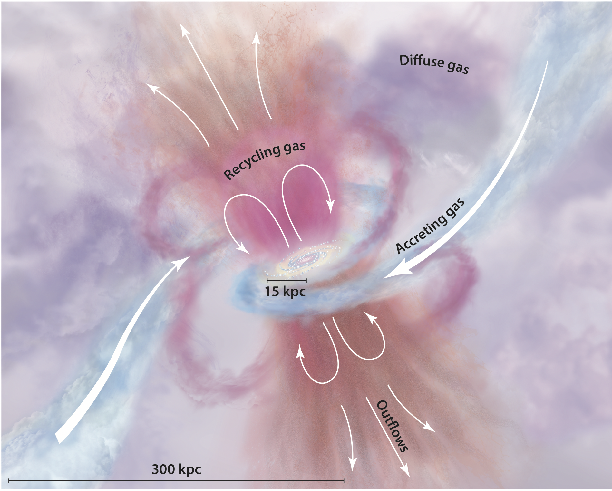
Galactic outflows and baryon cycle
Talk by Ivana Bešlić
Tumlinson+2017
Gas outflows driven by
Stellar feedback
  Supernova explosions
  Stellar winds
Active galactic nucleus (AGN)
  Radiation
  Jets
e.g. Veilleux+2005, 2020
Key roles
Regulate star formation
Transport metals to IGM

Slide 6
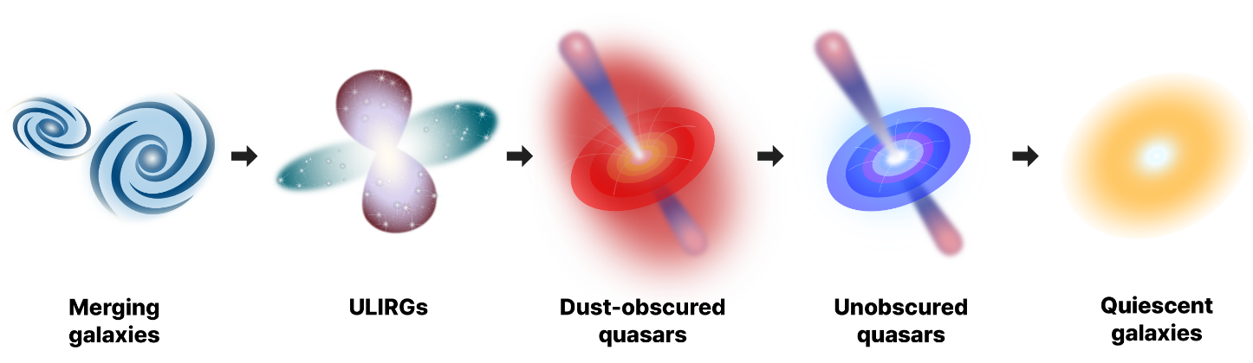
Molecular outflows in galaxy evolution
Star formation & SMBH growth regulated by outflows
What happens to molecular gas (fuel for star formation)?
Kim+2024
Quiescent galaxies at z > 4; Straatman+2014, Looser+2023

Slide 7
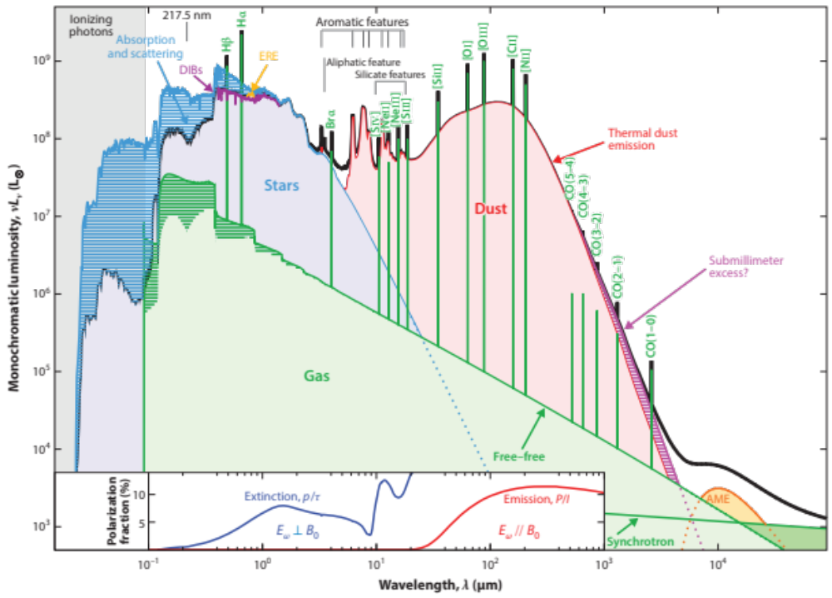
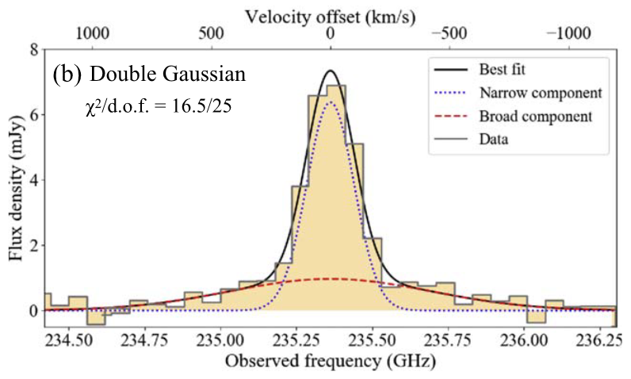
Probing molecular outflows
system
outflow
[C II] 158 μm in a quasar at z=7.07
Izumi+2021
Galliano+2018

Slide 8
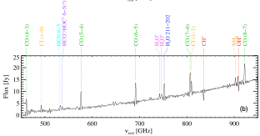
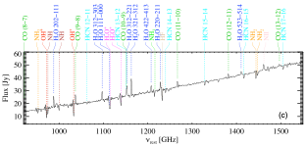
Nearby ULIRG Arp 220
Observations by Herschel
Emission
H₂O H₂O⁺
CO NH₂
Absorption
H₂O⁺ CH⁺ OH⁺
HF NH NH₂
Rangwala+2011

Slide 9


Molecular lines: OH (hydroxyl radical)
Flux
²П_{3/2}
²П_{1/2}
OH gas
Absorption line
J=5/2
outflow
400
Quasar
Continuum
Observer
Doppler shift
300
J=7/2
J=3/2
Observed wavelength
E/k [K]
200
J=1/2
What can be measured?
Line-of-sight velocity → Escape into IGM?
OH column density
Mass outflow rate & kinetic energy
J=5/2
Ground-state absorption probes cold/low density gas
100
119 μm
J=3/2

Slide 10
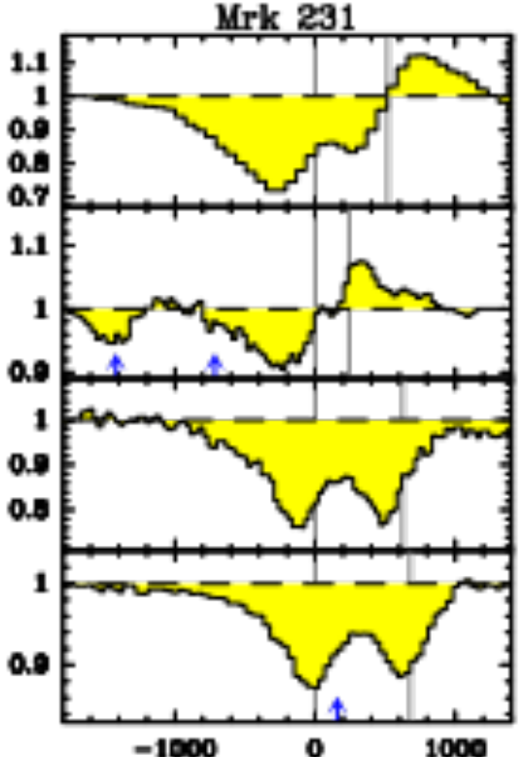
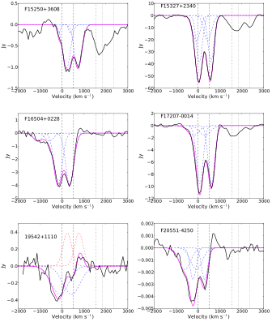
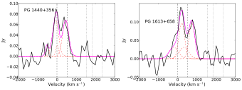
OH in nearby galaxies (revealed by Herschel)
ULIRG
OH 119 μm outflows in 70% AGN
→ isotropic geometry?
Emission in AGN-dominant systems
→ high excitation
119 μm
largest τ
H₂O
79
Normalized flux
84
65
Velocity [km/s]
Median velocity ~ 200 km/s
Gonzalez-Alfonso+2017
Veilleux+2013

Slide 11
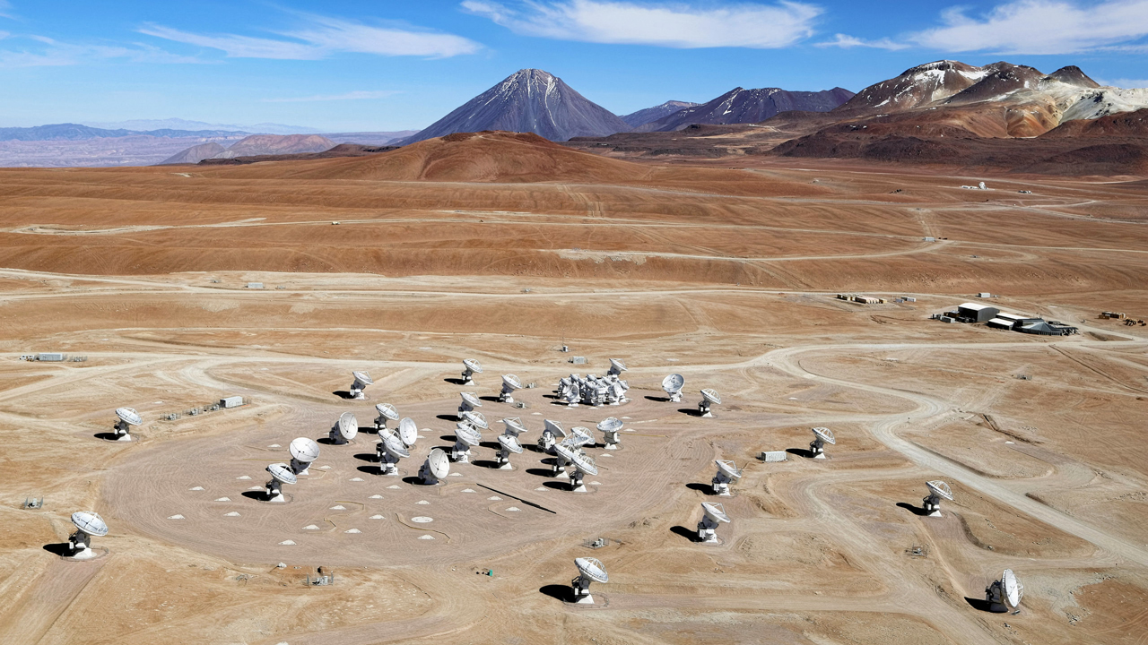
ALMA
© Clem & Adri Bacri-Normier/wingsforscience.com/ESO

Slide 12
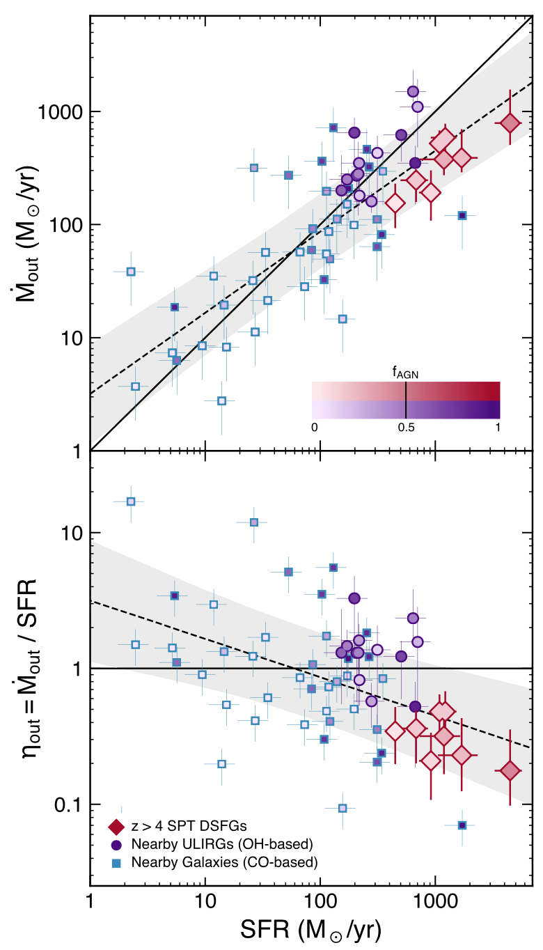
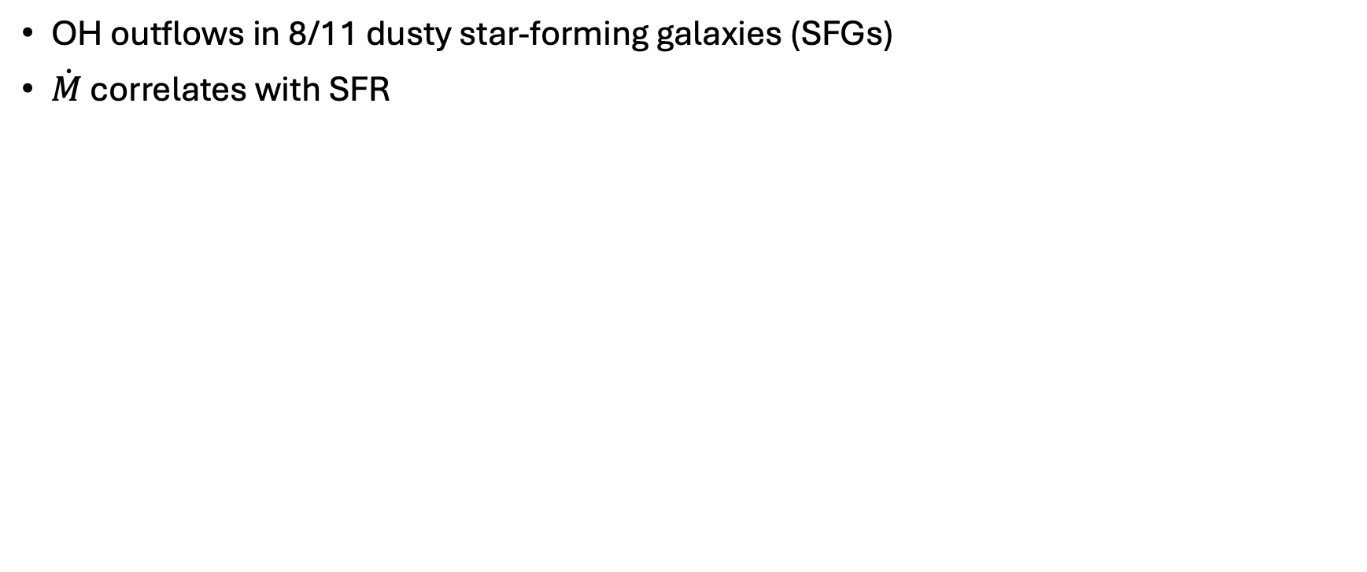
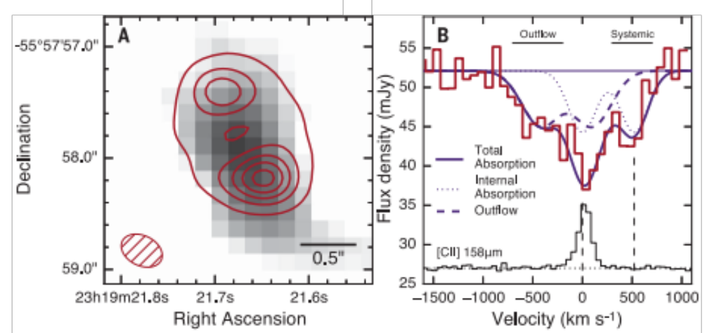
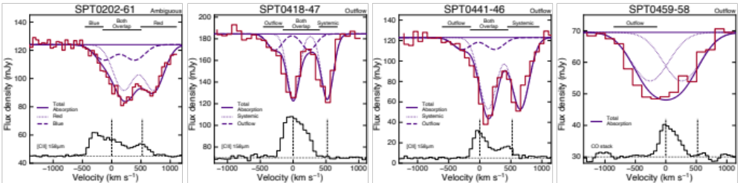
OH 119 μm in DSFGs at z~4-5
Spilker+2020
No outflows in [C II] 158 μm
Spilker+2018
Lensed DSFG at z~5.3
DSFGs at 4<z<5

Slide 13
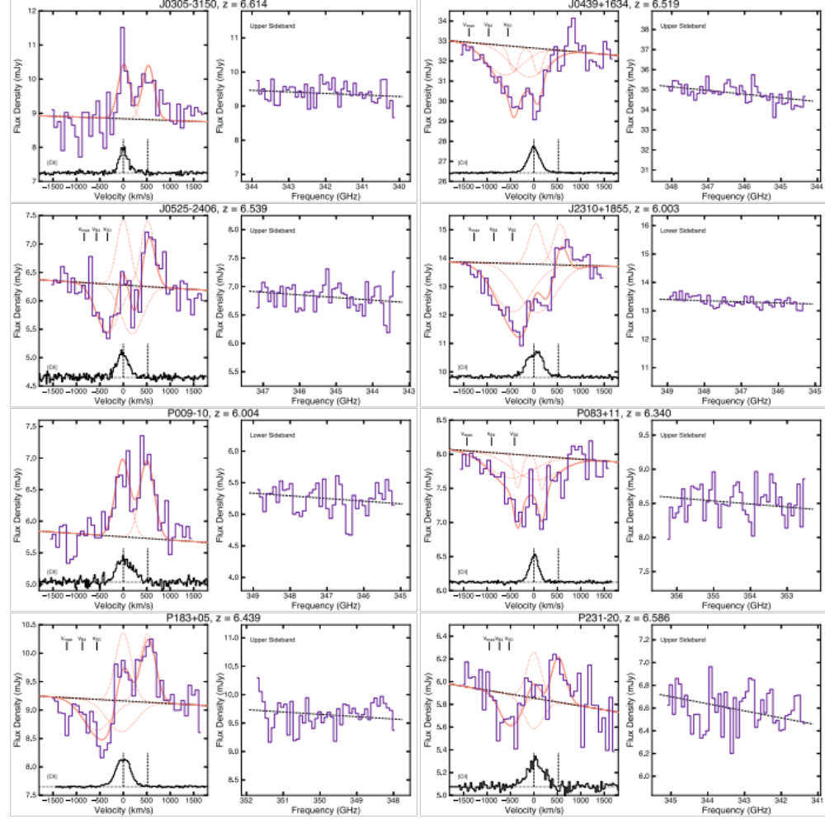
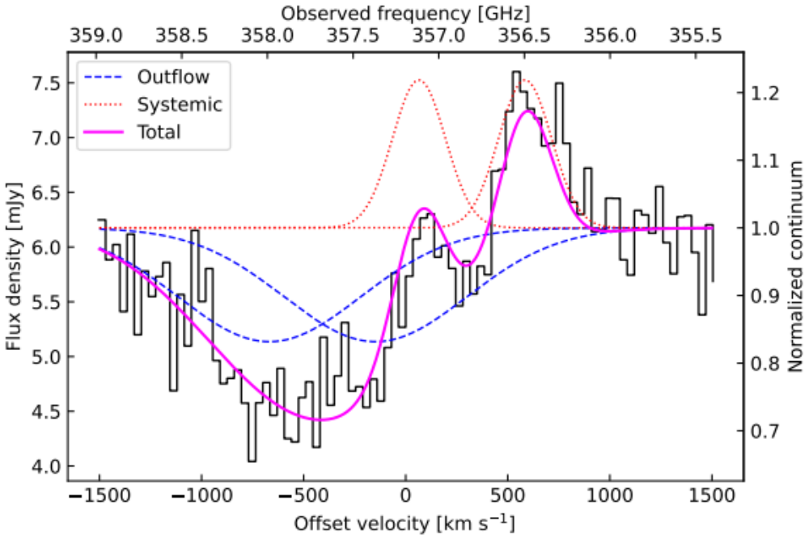
OH 119 μm in quasars at z~6
Spilker+2025
OH outflows in 80% sources:
→ molecular outflows are ubiquitous!
Salak+2024

Slide 14
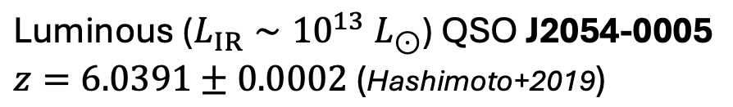
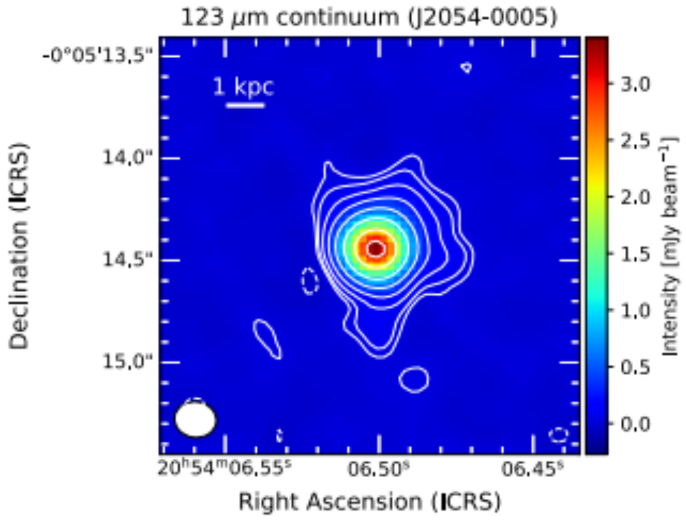
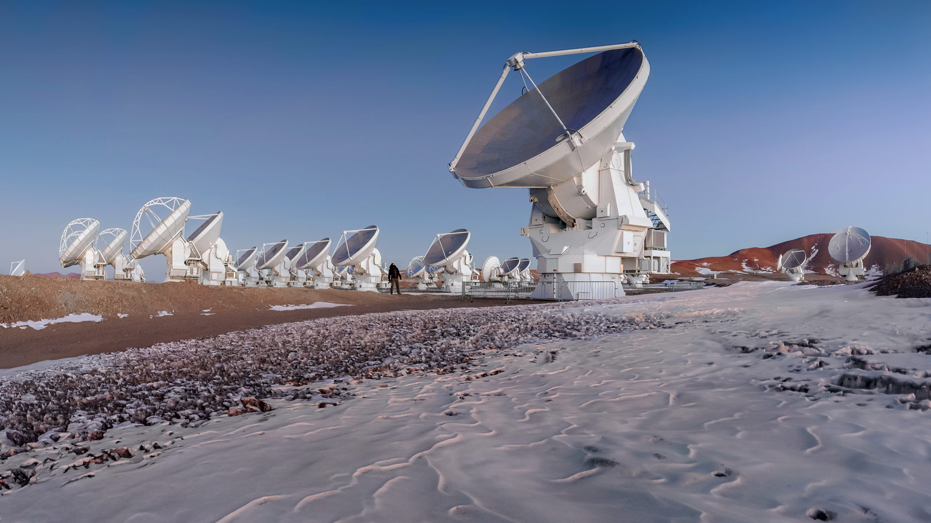
ALMA observations of a quasar at z = 6.04
D. Salak, T. Hashimoto, A.K. Inoue, T.J.L.C. Bakx, D. Donevski, Y. Tamura, Y. Sugahara, N. Kuno, Y. Miyamoto, S. Fujimoto, & S. Suphapolthaworn, 2024, ApJ, 962, 1
Observations in ALMA cycle 10 (P.I. DS)
Angular resolution 0.2” (~ 1 kpc)
Spectral resolution 35 km/s)
120 μm
ALMA "Credit: D. Kordan (ESO)"

Slide 15
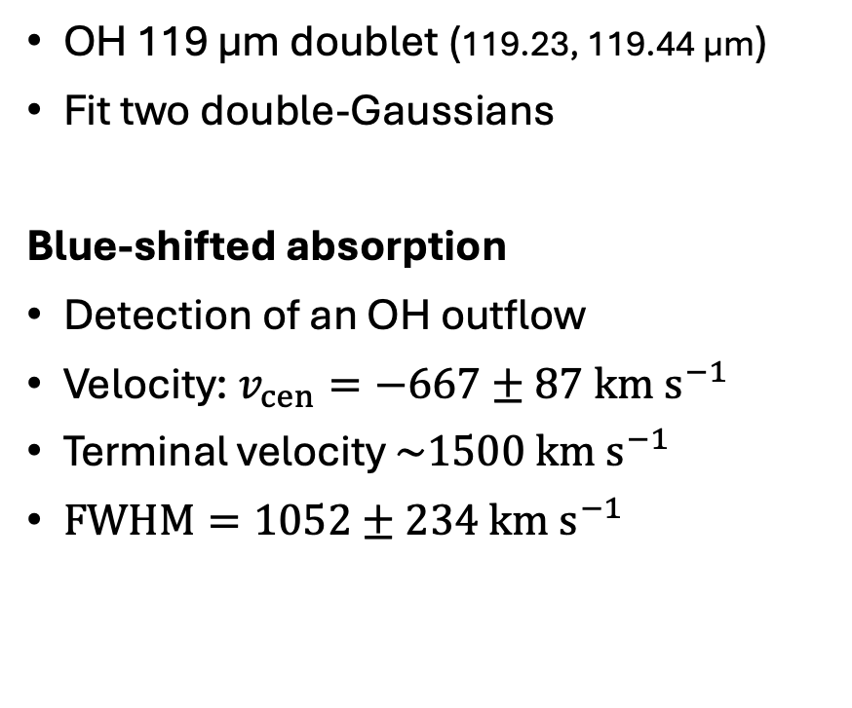
Molecular outflow
outflow
Fastest molecular outflow at high z
Salak+2024

Slide 16
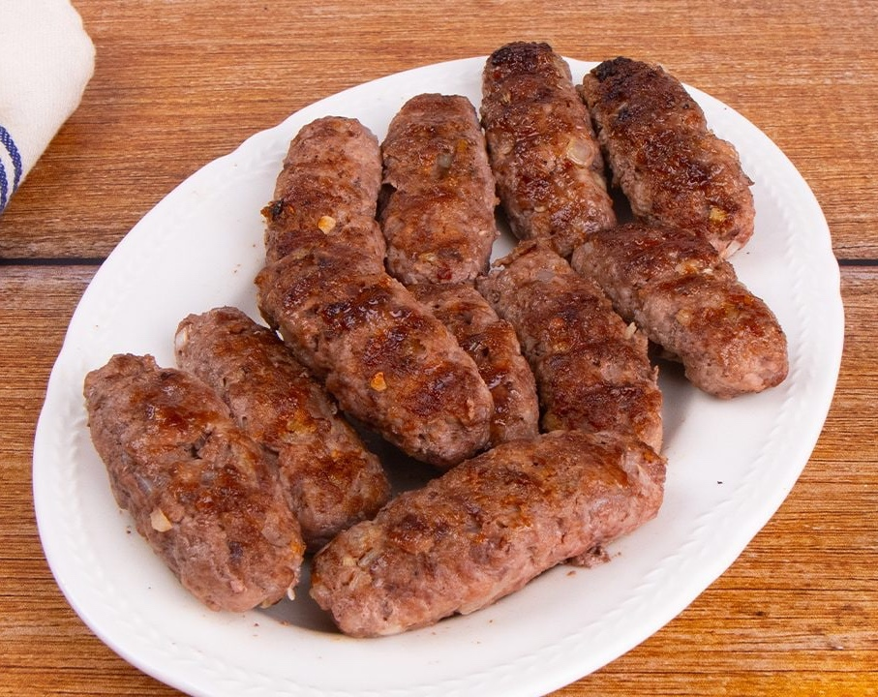


Outflow model
Credit: Ingrid Kallick
Ćevapčići (observed)
Ćevapčići (reality)
Our model

Slide 17
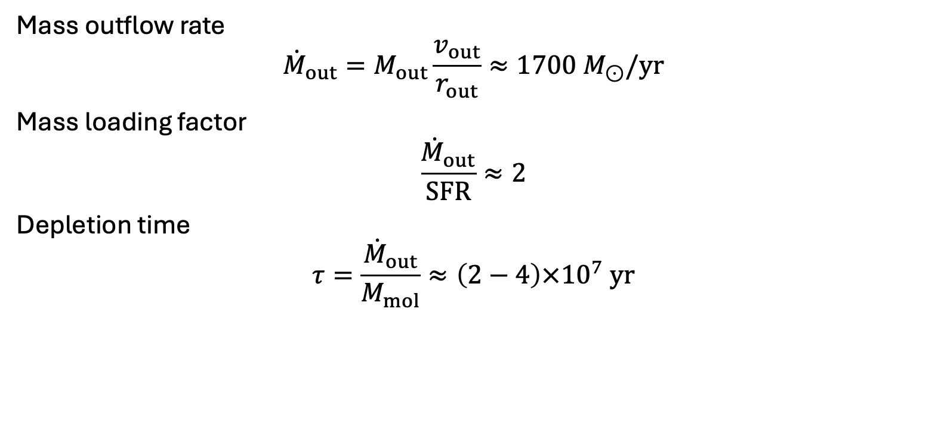


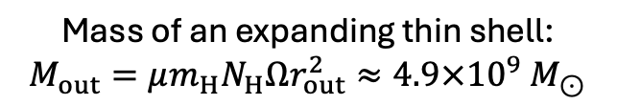
Impact on star formation
Evidence of rapid suppression of star foramation at z>6

Slide 18
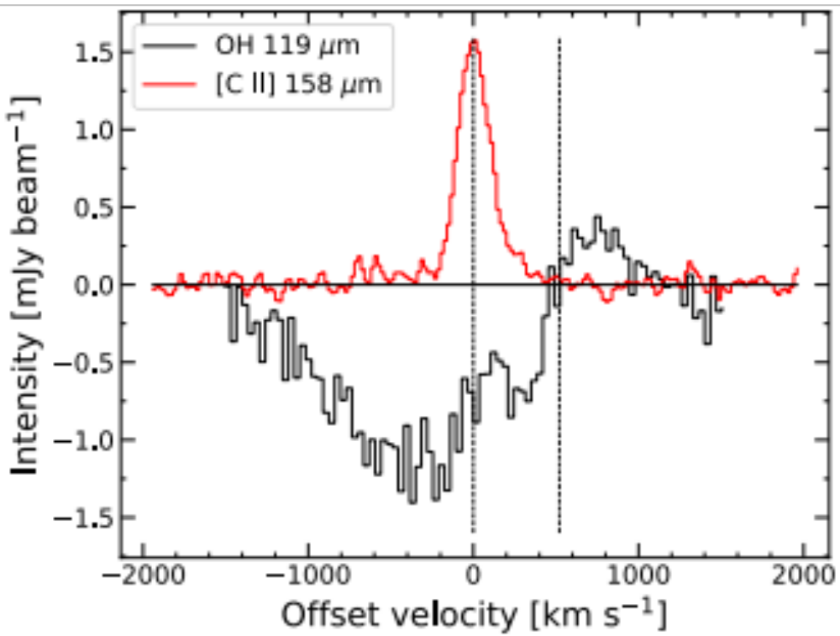
Outflow missed by [C II] 158 μm emission

Slide 19
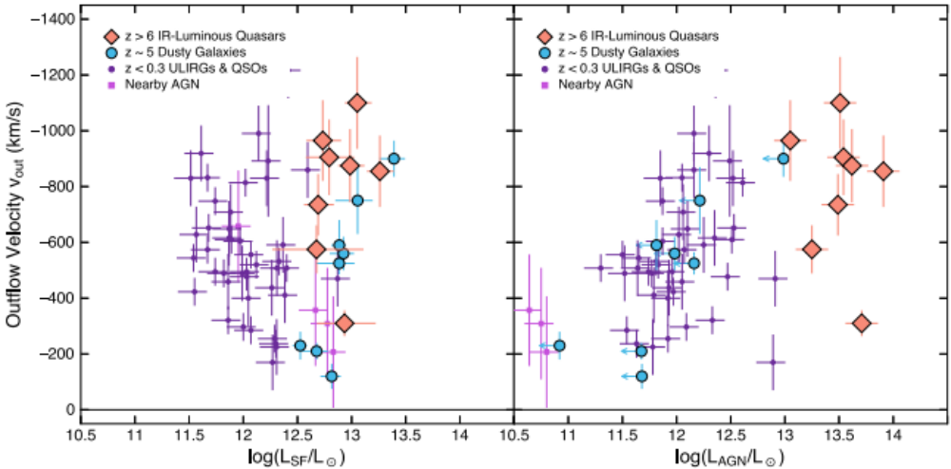
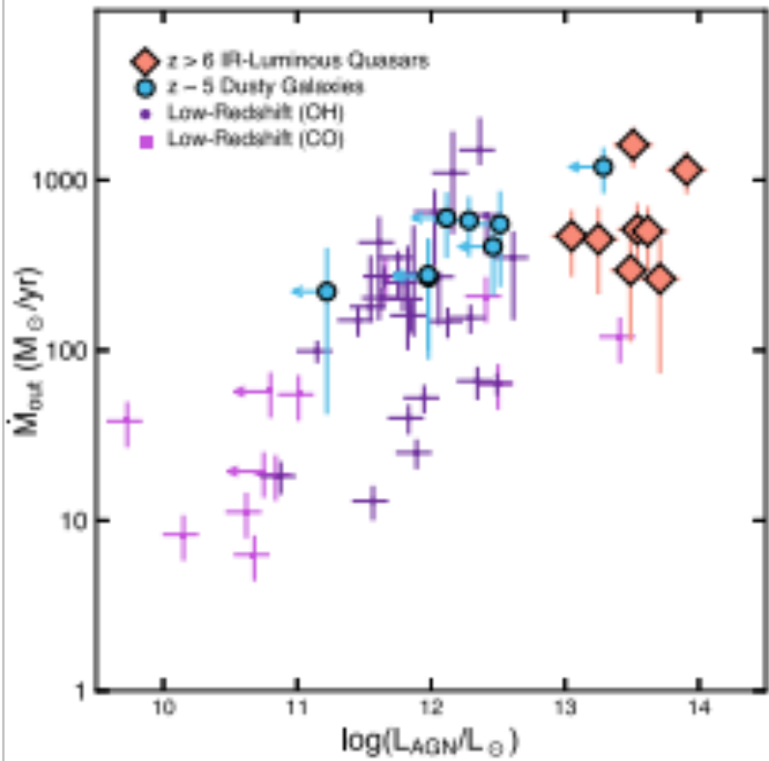
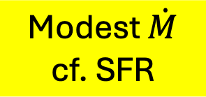
Evidence of AGN feedback
V_{out} correlates with L_{AGN}
Spilker+2025

Slide 20
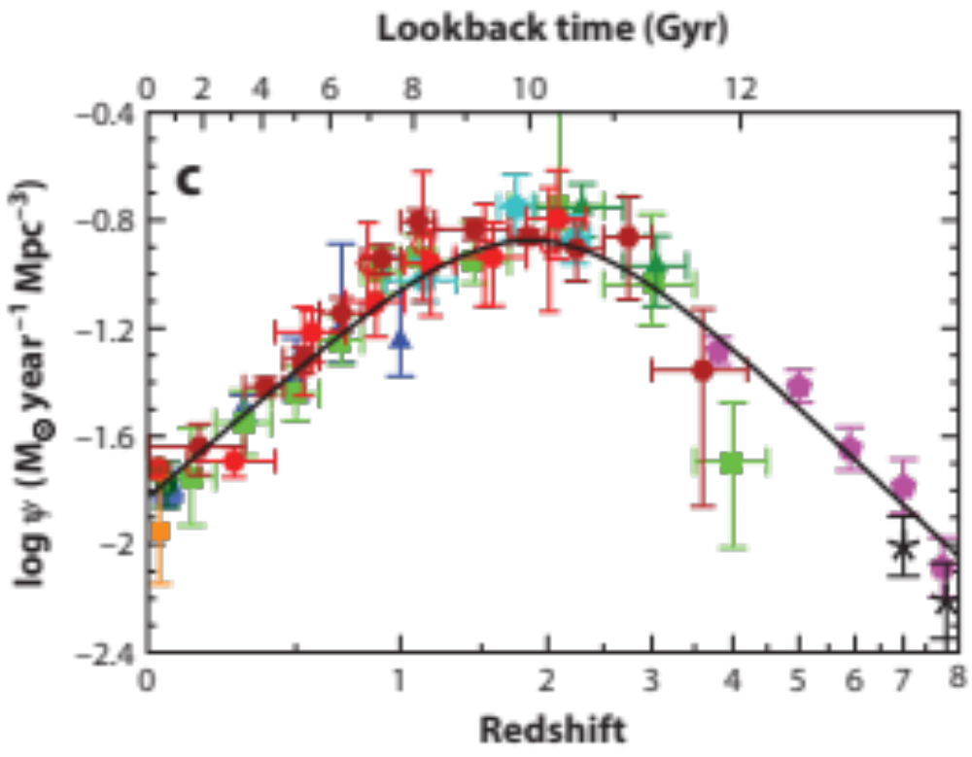
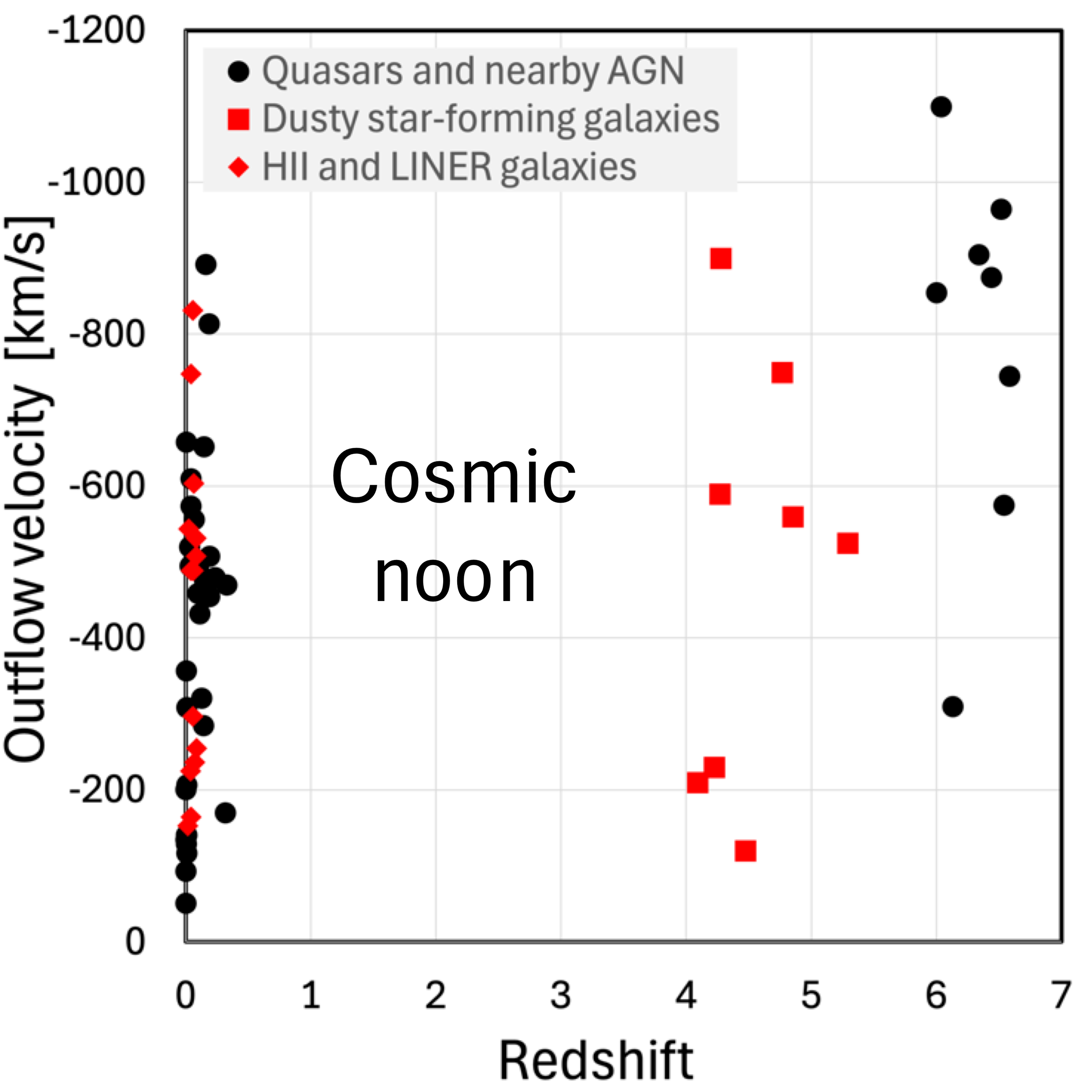
OH outflows vs. redshift
First ALMA observations of OH in Hot DOGs at z=3 just finished!
No data at 0.5 < z < 4
Cosmic noon
?
Madau & Dickinson 2014

Slide 21
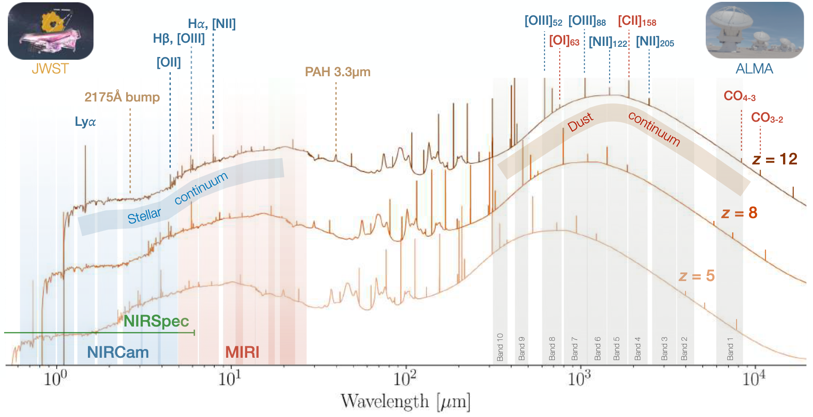
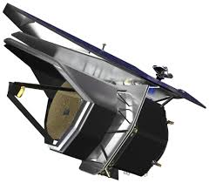
Future: The Probe far-Infrared Mission for Astrophysics
PRIMA (24-235 μm)
OH₁₁₉ (z=5)
OH₁₁₉ (z=0)
Modified from Herrera-Camus+2026

Slide 22
Summary
Studying molecular outflows via absorption lines at z > 2
70-80% detection rate of OH 119 μm outflows → isotropic & ubiquitous
Case study
  ALMA observations of OH 119 μm in the quasar J2054-0005 at z=6.04
  Mass outflow rate exceeds SFR by ~2
  Evidence of rapid suppression of SF in SFGs and quasars
Future instruments (PRIMA) will probe outflows at z ~ 0 – 2

Slide 23
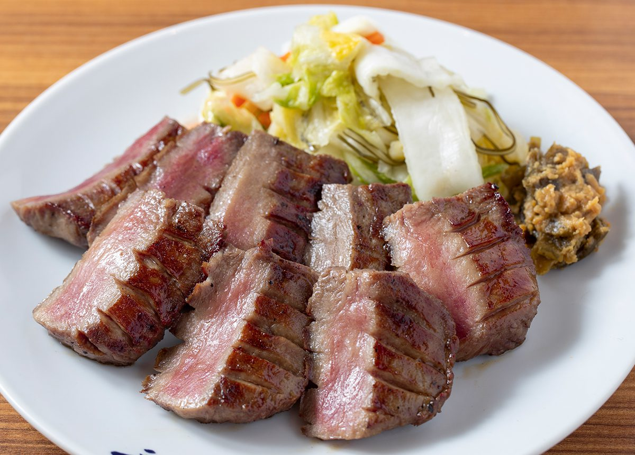


Thank you!
Beef tongue
(local specialty)
Tanabata festival
(early August)
Matsushima island
(best 3 views in Japan)

Slide 24
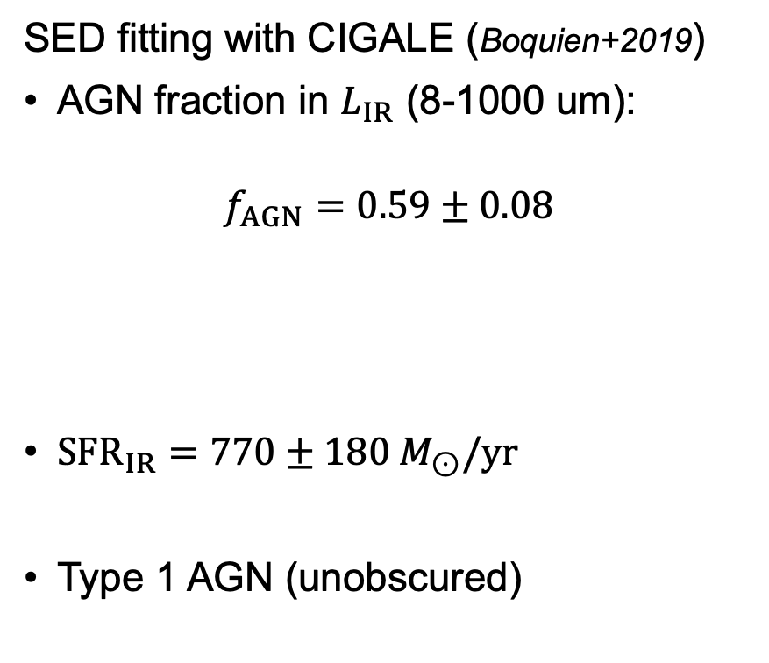

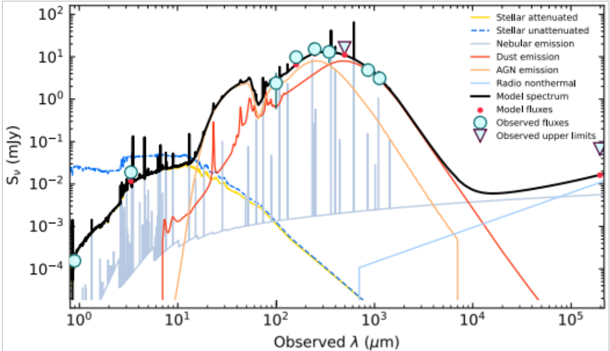
Impact on star formation
SFR overestimated by 2x?
cf. FWHM(Lya) ~ 4890 km/s (Jiang+2008)

Slide 25
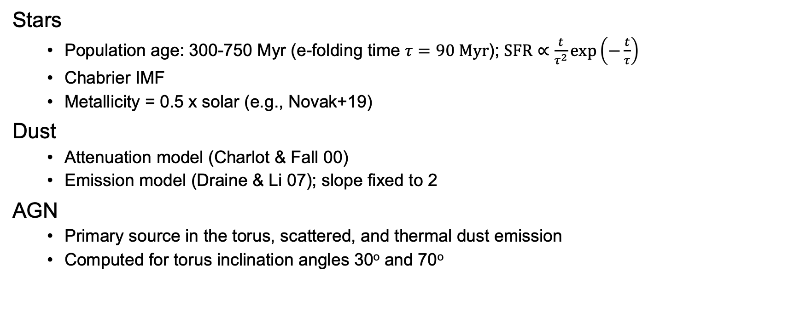
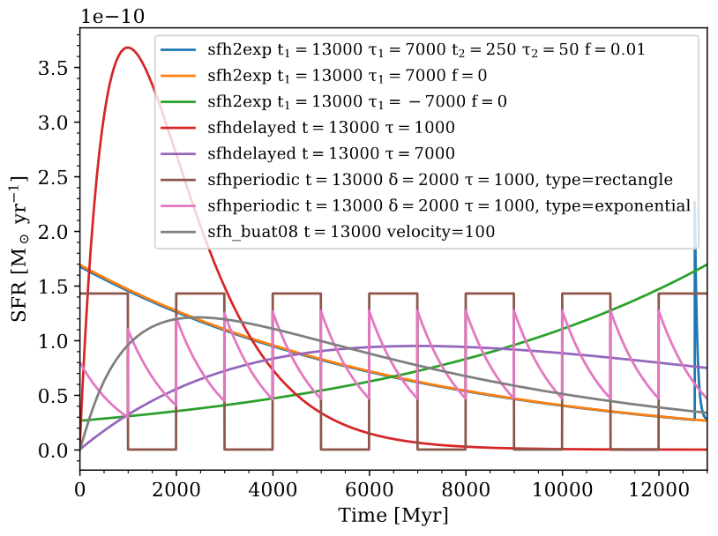
CIGALE model input parameters
Boquien+19

Slide 26
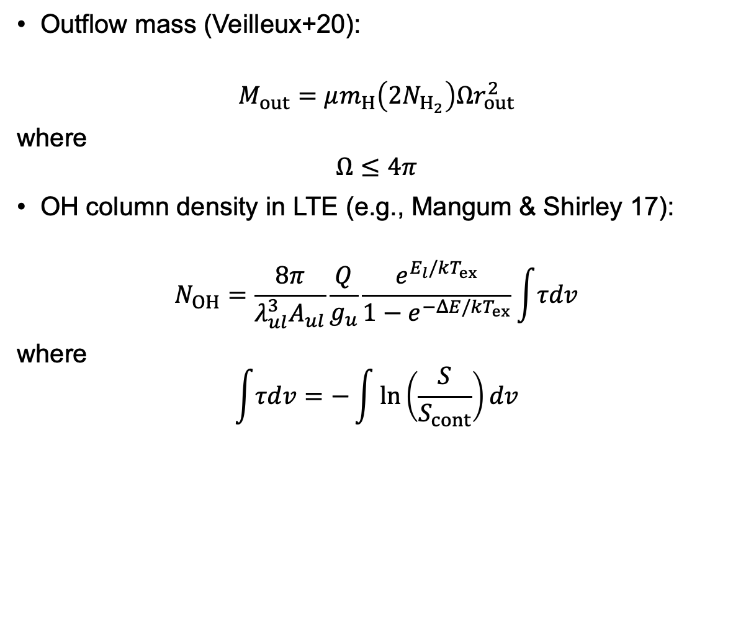




Thin-shell outflow model
Opening angle
Expanding thin shell (e.g., Veilleux+20)

Slide 27
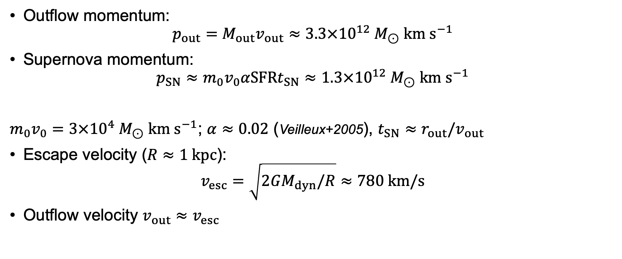
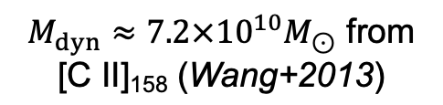
Outflow energetics
If SF-driven…
high coupling efficiency?
Up to ~50% of outflowing molecular escaping to IGM?

